Slide 1
정보통신기기 소프트웨어
IoT Project
대덕소프트웨어 마이스터 고등학교
임베디드 3학년

Slide 2
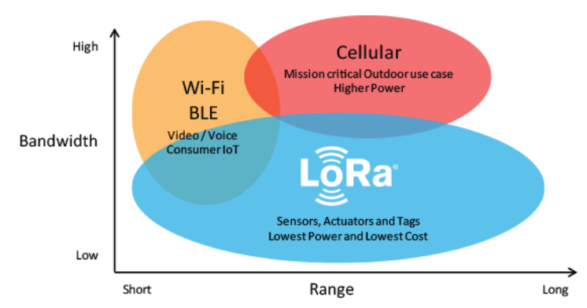
IoT 통신 방식 비교
Zigbee
Semtech LoRa Technology Overview | Semtech

Slide 3
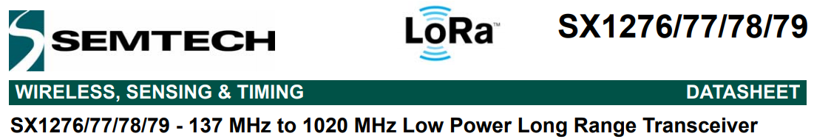
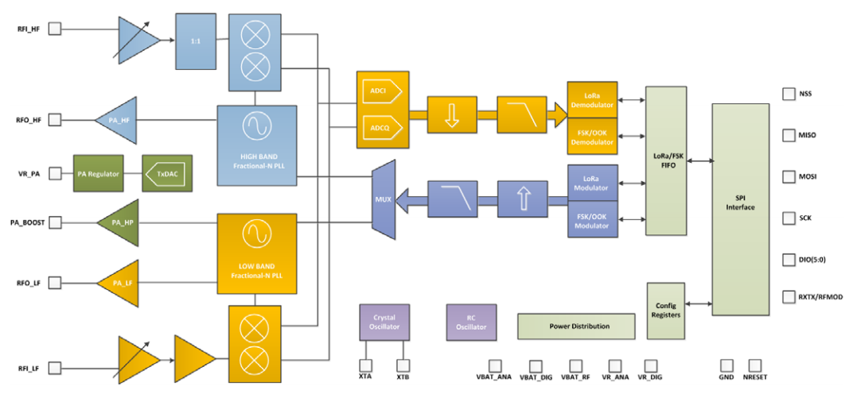

Slide 4
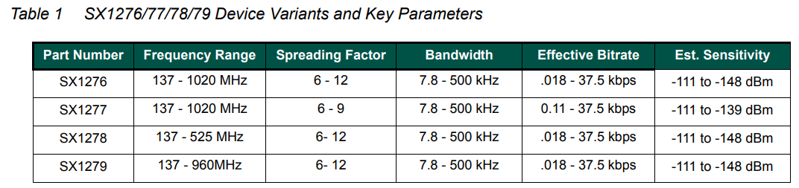

Slide 5
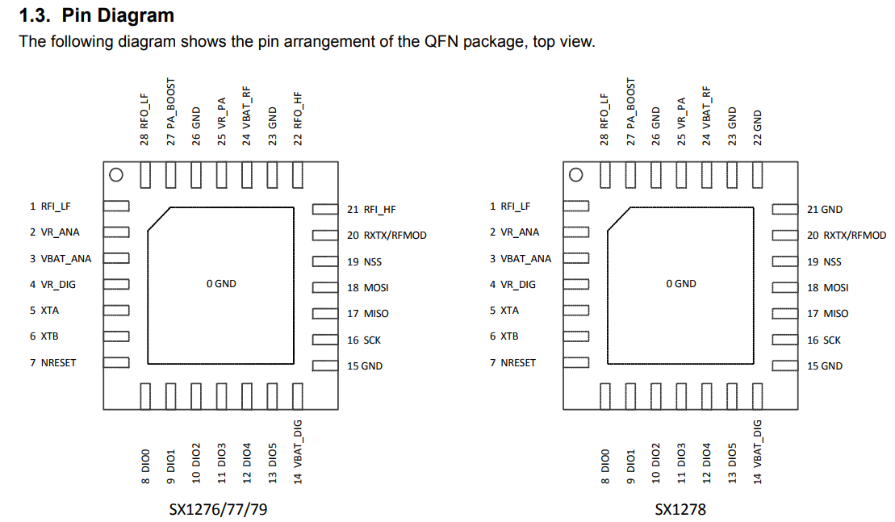

Slide 6
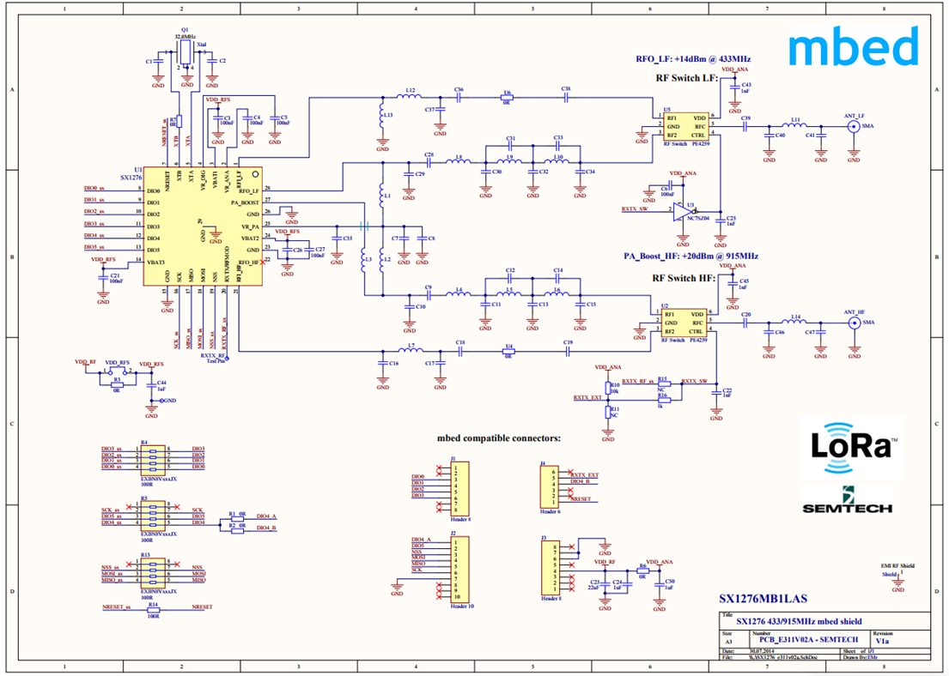

Slide 7
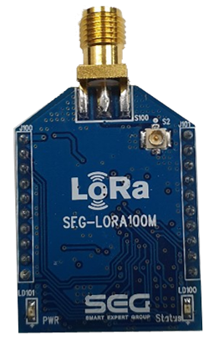
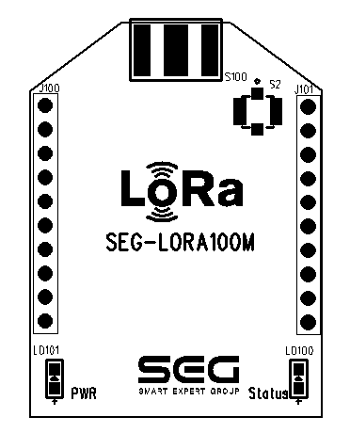
LoRa SX1276 Module
digi사의 XBEE와 pin to pin 호환
SMA
Connector
Pin No. | Name | 기능
1 | VCC | +3.0 ~ +3.3V
2 | TX | MCU → RF
3 | RX | RF → MCU
4 | NC | -
5 | NC | -
6 | NC | -
7 | NC | -
8 | NC | -
9 | NC | -
10 | GND | Ground
Pin No. | Name | 기능
11 | NC | -
12 | nRESET | Active Low
13 | ISP | Not Connect
14 | NC | -
15 | NC | -
16 | NC | -
17 | NC | -
18 | NC | -
19 | NC | -
20 | NC | -
IPEX
Connector
1번핀
Power LED
State LED
1
2
3
4
5
6
7
8
9
10
20
19
18
17
16
15
14
13
12
11
Tx, Rx = UART Level

Slide 8
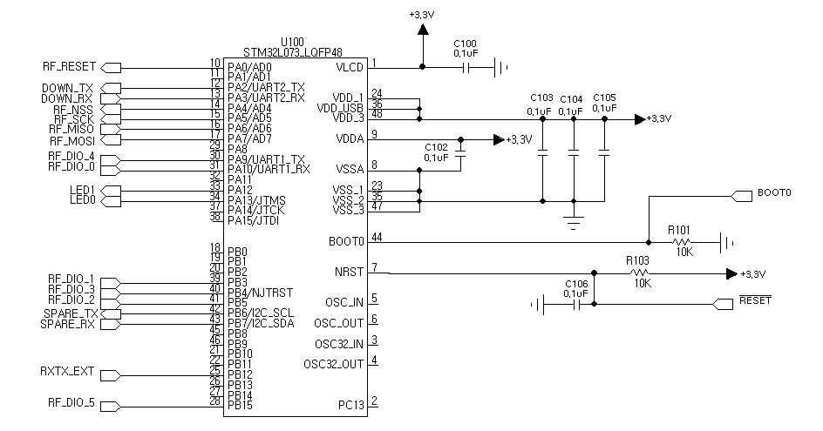
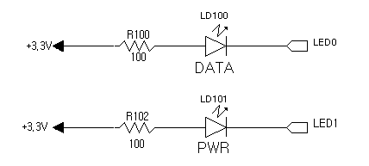
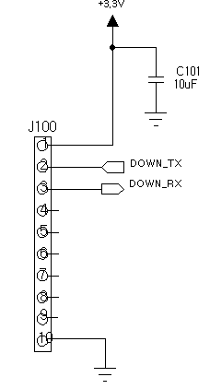
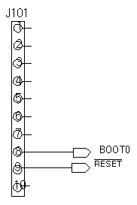
LoRa SX1276 Module . Schematic

Slide 9
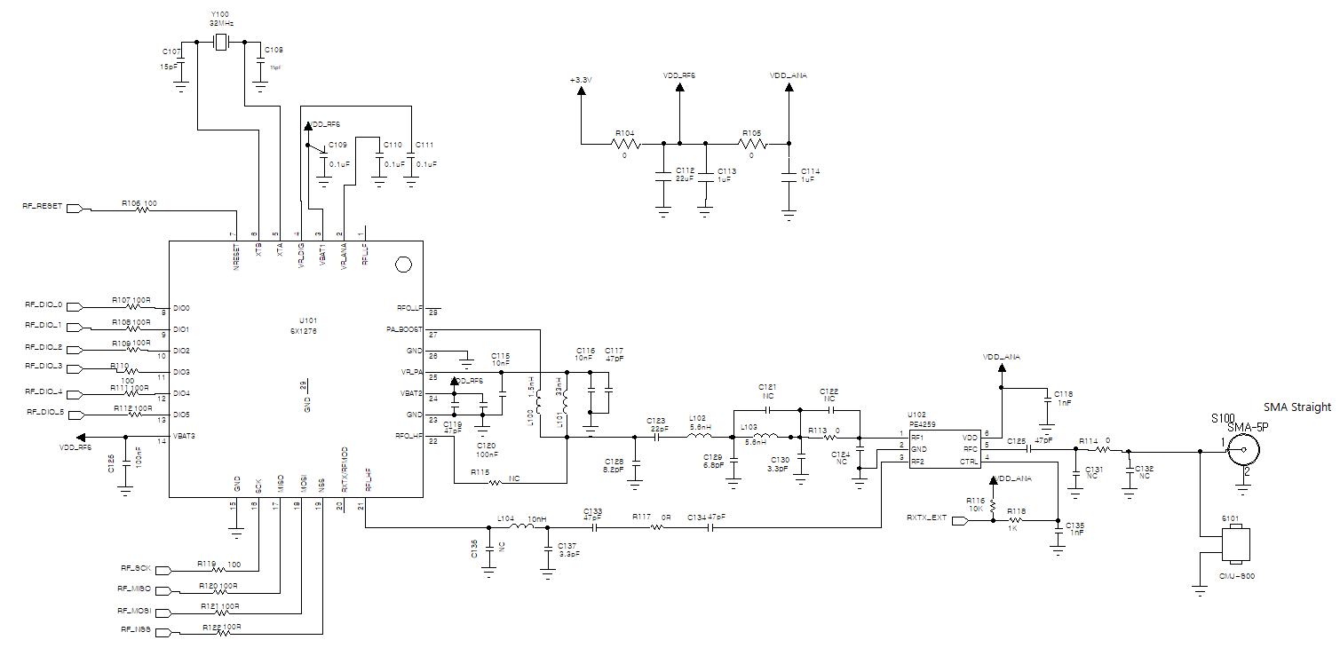
LoRa SX1276 Module . Schematic

Slide 10
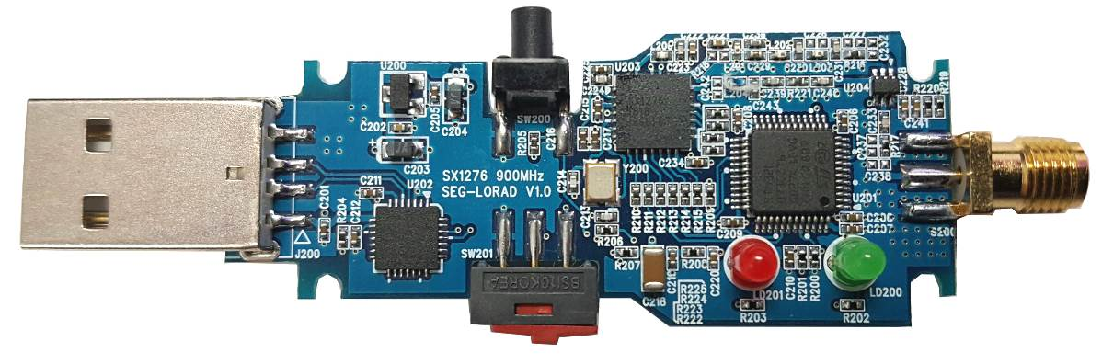
LoRa SX1276 Dongle
RESET 버튼
USB 커넥터
SMA 커넥터
전원 LED
전송 LED
동작 전환 버튼
슬라이더 스위치를 USB 커넥터 쪽으로 이동하면
Program mode

Slide 11
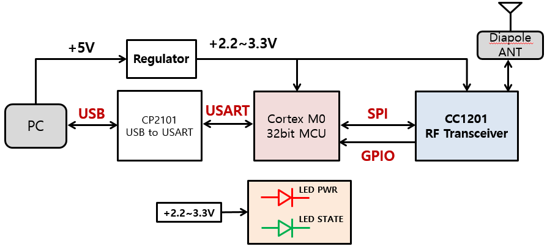
LoRa SX1276 Dongle . block diagram

Slide 12
LoRa SX1276 Module . Setting
Channel | 주파수 Mhz | 최대송신전력
0 | 917.3 | 10mW
1 | 917.9 | 10mW
2 | 918.5 | 10mW
3 | 919.1 | 10mW
4 | 919.7 | 10mW
5 | 920.3 | 10mW
6 | 920.7 | 10mW
7 | 920.9 | 10mW
8 | 921.1 | 10mW
9 | 921.3 | 10mW
10 | 921.5 | 10mW
11 | 921.7 | 10mW
12 | 921.9 | 10mW
13 | 922.1 | 25mW
14 | 922.3 | 25mW
15 | 922.5 | 25mW
16 | 922.7 | 25mW
17 | 922.9 | 25mW
18 | 923.1 | 25mW
19 | 923.3 | 25mW
1. SETFREQ=n(channel)
ex) SETFREQ=922.1\r
2. 송신 출력 설정 : SETPOWER=n (n= 0 ~ 20[dB] )
ex) SETPOWER=20\r
3. 설정값 저장 : SETSAVE\r
ex) SETSAVE\r

Slide 13
모뎀 설정 명령
명령어는 'S' 또는 's'로 시작하여야 하며 종료는 0x0d로 끝나야함 길이가 틀리면 처리불가, 공백문자 넣지 말것
명령어 | 인수 | EX | 비고 | 길이 (0x0d포함)
SETCLIENT | 0~500 | "SETCLIENT=0" | 0이면 서버로 동작 그렇지않으면 클라이언트로 동작하고 RXTIMEOUT= 인수 *1000 ms | 12 | 클라이언트 모드일때는 TX후 RXTIMEOUT 값만큼만 RX로 대기함
SETFREQ | 917.1~923.3 | "SETFREQ=917.1" | 소수점이 안들어가면 에러 ex) 917 error => 917.0 | 14 | 자리수와 소수점 신경써서 입력
SETOFFSET | "-1000000~+1000000" | "SETOFFSET=-1000000" "SETOFFSET=12345" "SETOFFSET=0" | 음수인경우 부호값이 반드시 붙어야하며 - 1000000 ~1000000 이내의 값이어야함 | 12~19 | 양수일때는 부호 필요 없음
SETSF | 7~12 | "SETSF=7" "SETSF=12" |  | 8~9
SETPOWER | 0~20 | "SETPOWER=12" "SETPOWER=2" |  | 12
모든 설정값은 SETSAVE 이후에 플래쉬에 저장되므로 설정을 영구적으로 저장하기위해서는 SETSAVE명령을 내려서 저장할것

Slide 14

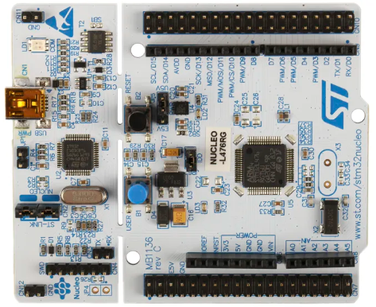
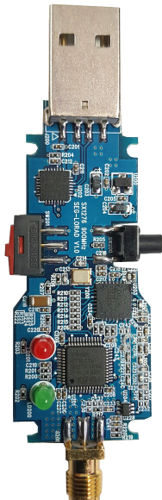

실습 환경
End-Node
Coordinator
Sensors
Sensor Monitoring
&
Actuator
Control
UART
Actuator

Slide 15
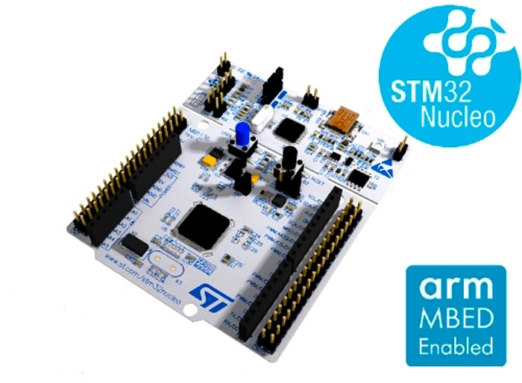
NUCLEO-L476RG CubeMx & CubeIDE
STM32L476RGT6V
Ultra-Low-Power with FPU ARM
Cortex-M4 MCU 80MHz with
1 Mbyte of Flash memory
LCD, USB OTG, DFSDM

Slide 16
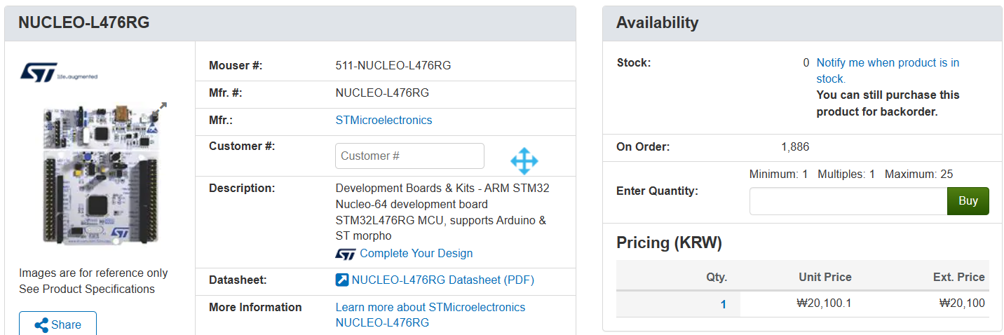
NUCLEO-L476RG

Slide 17
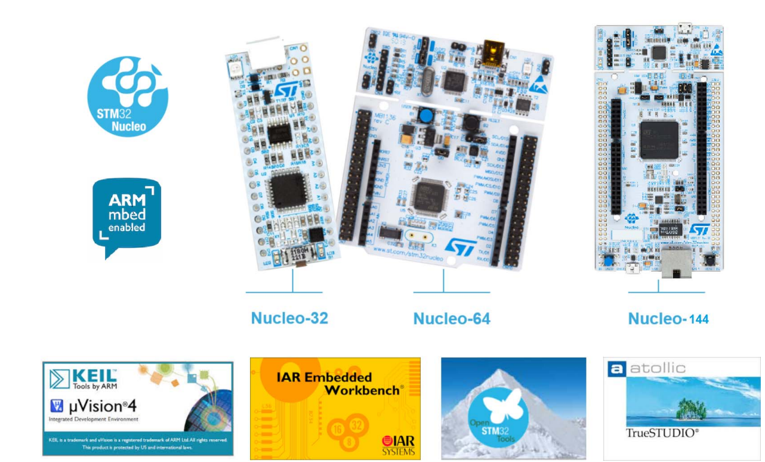
Nucleo development tools

Slide 18
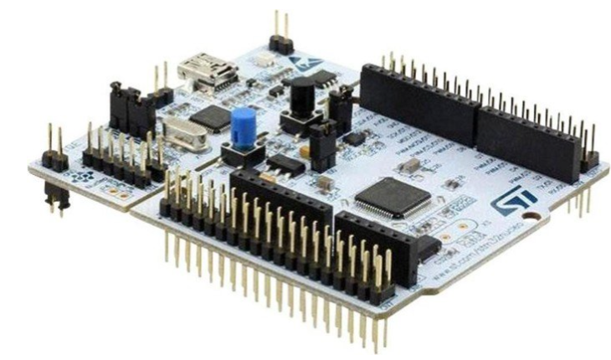
NUCLEO-L476RG Features
STM32 microcontroller in an LQFP64 or LQFP48 package
1 user LED shared with ARDUINO®
1 user and 1 reset push-buttons
32.768 kHz crystal oscillator
Board connectors:
ARDUINO® Uno V3 expansion connector
ST morpho extension pin headers for full access to all STM32 I/Os
Flexible power-supply options: ST-LINK USB V_{BUS} or external sources
On-board ST-LINK debugger/programmer with USB re-enumeration capability: mass storage, Virtual COM port, and debug port
Comprehensive free software libraries and examples available with the STM32Cube MCU Package
Support of a wide choice of Integrated Development Environments (IDEs) including IAR Embedded Workbench®, MDK-ARM, and STM32CubeIDE

Slide 19
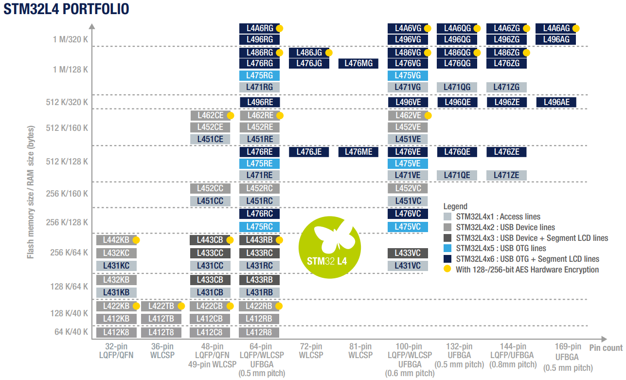
STM32L4 Portfolio

Slide 20
STM32L476RGT6 Features
Ultra-low-power with FlexPowerControl – 1.71 V to 3.6 V power supply – -40 °C to 85/105/125 °C temperature range – 300 nA in VBAT mode: supply for RTC and 32x32-bit backup registers – 30 nA Shutdown mode (5 wakeup pins) – 120 nA Standby mode (5 wakeup pins) – 420 nA Standby mode with RTC – 1.1 µA Stop 2 mode, 1.4 µA with RTC – 100 µA/MHz run mode – Batch acquisition mode (BAM) – 4 µs wakeup from Stop mode – Brown out reset (BOR) – Interconnect matrix

Slide 21
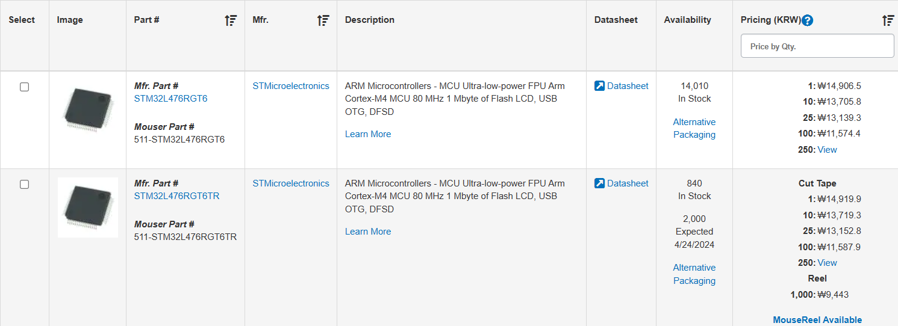
STM32L476RGT6 Price

Slide 22
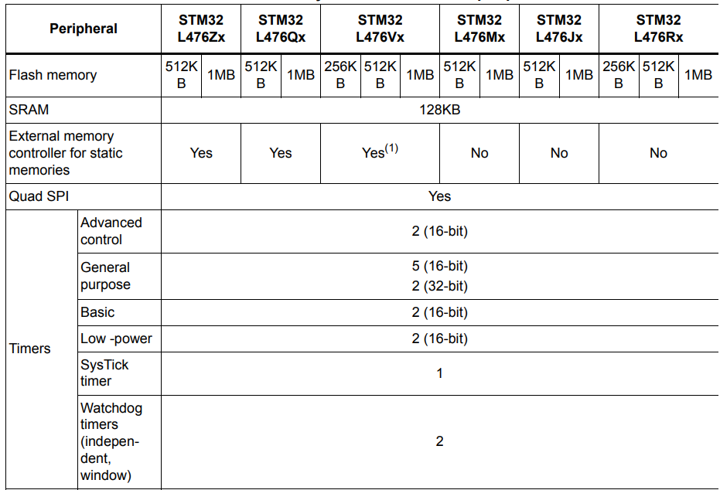
STM32L476RGT6 Features

Slide 23
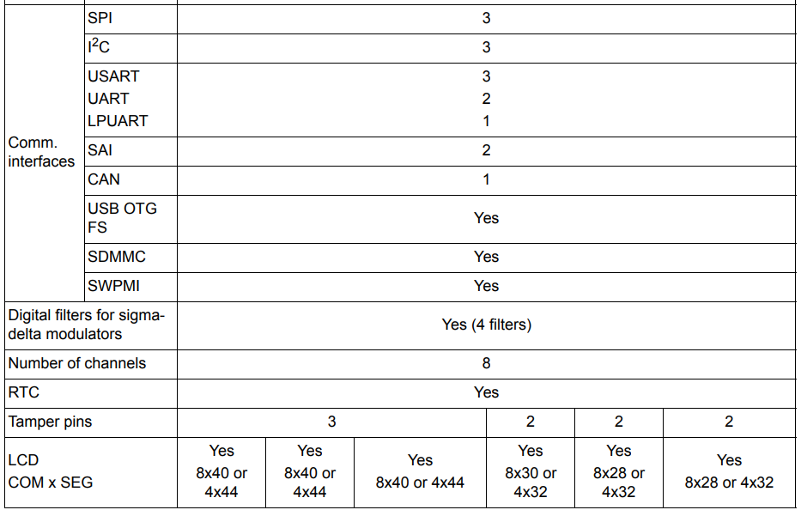
STM32L476RGT6 Features

Slide 24
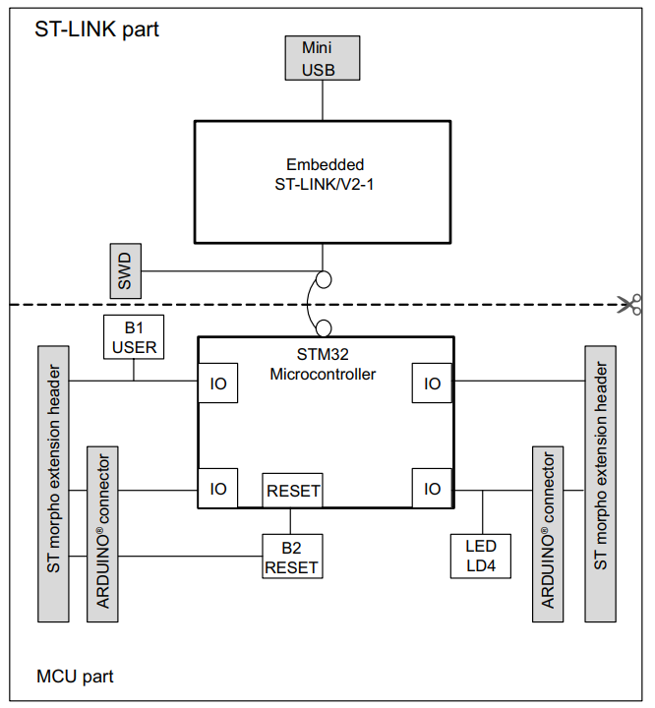
NUCLEO-L476RG . Hardware block diagram

Slide 25
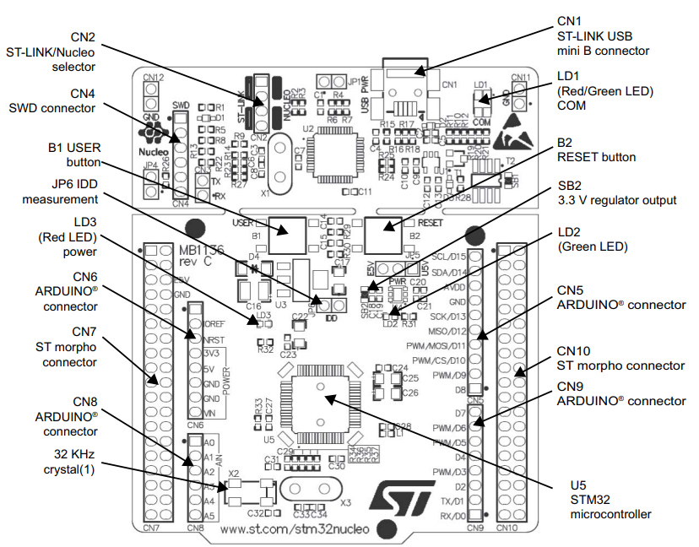
NUCLEO-L476RG . Top Layout

Slide 26
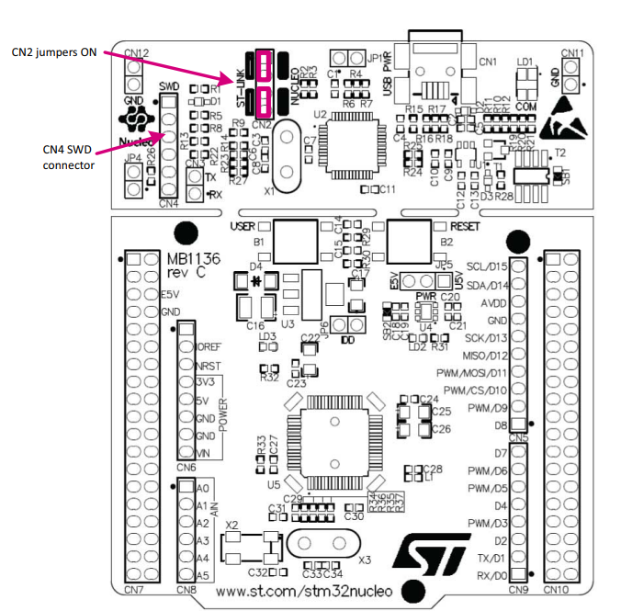
NUCLEO-L476RG . Using the ST-LINK/V2-1 to program and debug the STM32 on board
To program the STM32 on the board, plug in the two jumpers on CN2, as shown in red in Figure.
Do not use the CN4 connector as this could disturb the communication with the STM32 microcontroller of the STM32 Nucleo board.

Slide 27
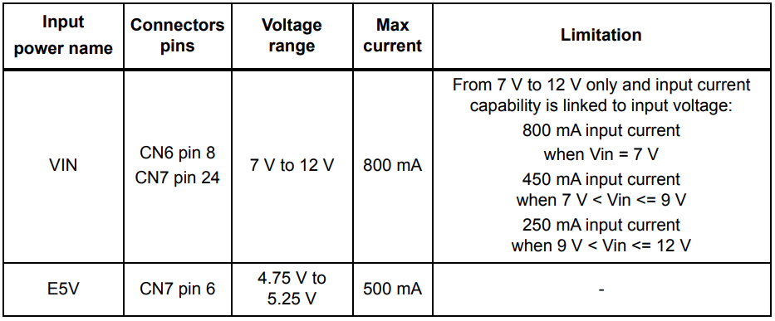
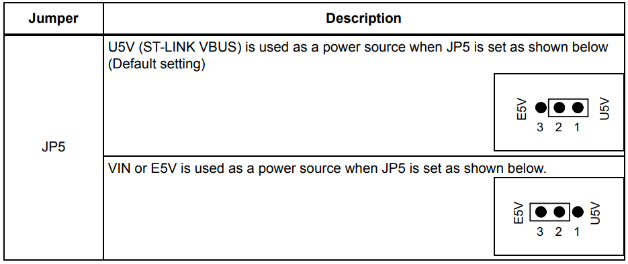
NUCLEO-L476RG . External power supply inputs: VIN and E5V

Slide 28
NUCLEO-L476RG . Using VIN or E5V as external power supply
1. Connect the jumper between pin 2 and pin 3 of JP5 2. Check that JP1 is removed 3. Connect the external power source to VIN or E5V 4. Power on the external power supply 7 V< VIN < 12 V to VIN, or 5 V for E5V 5. Check that LD3 is turned ON 6. Connect the PC to USB connector CN1
If this order is not respected, the board may be supplied by VBUS first then by VIN or E5V, and the following risks may be encountered: 1. If more than 300 mA current is needed by the board, the PC may be damaged or the current supply can be limited by the PC. As a consequence, the board is not powered correctly. 2. 300 mA is requested at enumeration (since JP1 must be OFF) so there is a risk that the request is rejected and the enumeration does not succeed if the PC cannot provide such current. Consequently, the board is not power supplied (LED LD3 remains OFF)

Slide 29
NUCLEO-L476RG . LEDs
The tricolor LED (green, orange, red) LD1 (COM) provides information about ST-LINK communication status. LD1 default color is red. LD1 turns to green to indicate that communication is in progress between the PC and the ST-LINK/V2-1, with the following setup: • Slow blinking Red/Off: at power-on before USB initialization • Fast blinking Red/Off: after the first correct communication between the PC and ST-LINK/V2-1 (enumeration) • Red LED On: when the initialization between the PC and ST-LINK/V2-1 is complete • Green LED On: after a successful target communication initialization • Blinking Red/Green: during communication with the target • Green On: communication finished and successful • Orange On: Communication failure User LD2: the green LED is a user LED connected to ARDUINO® signal D13 corresponding to STM32 I/O PA5 (pin 21) or PB13 (pin 34) depending on the STM32 target. Refer to Table 11 to Table 23 when: • the I/O is HIGH value, the LED is on • the I/O is LOW, the LED is off LD3 PWR: the red LED indicates that the STM32 part is powered and +5V power is available

Slide 30
NUCLEO-L476RG . Buttons
B1 USER: the user button is connected to the I/O PC13 (pin 2) of the STM32 microcontroller. B2 RESET: this push-button is connected to NRST, and is used to RESET the STM32 microcontroller.
Note: The blue and black plastic hats that are placed on the push-buttons can be removed if necessary, for example when a shield or when an application board is plugged on top of the Nucleo board. This will avoid pressure on the buttons and consequently a possible permanent target STM32 RESET.

Slide 31
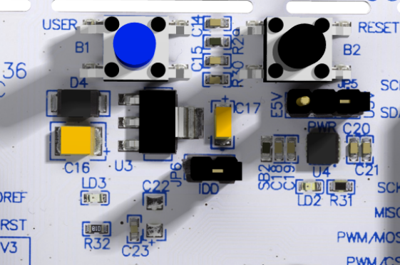
NUCLEO-L476RG . JP6(IDD)
Jumper JP6, labeled IDD, is used to measure the STM32 microcontroller consumption by removing the jumper and by connecting an ammeter: • Jumper ON: STM32 microcontroller is powered (default). • Jumper OFF: an ammeter must be connected to measure the STM32 microcontroller current. If there is no ammeter, the STM32 microcontroller is not powered

Slide 32
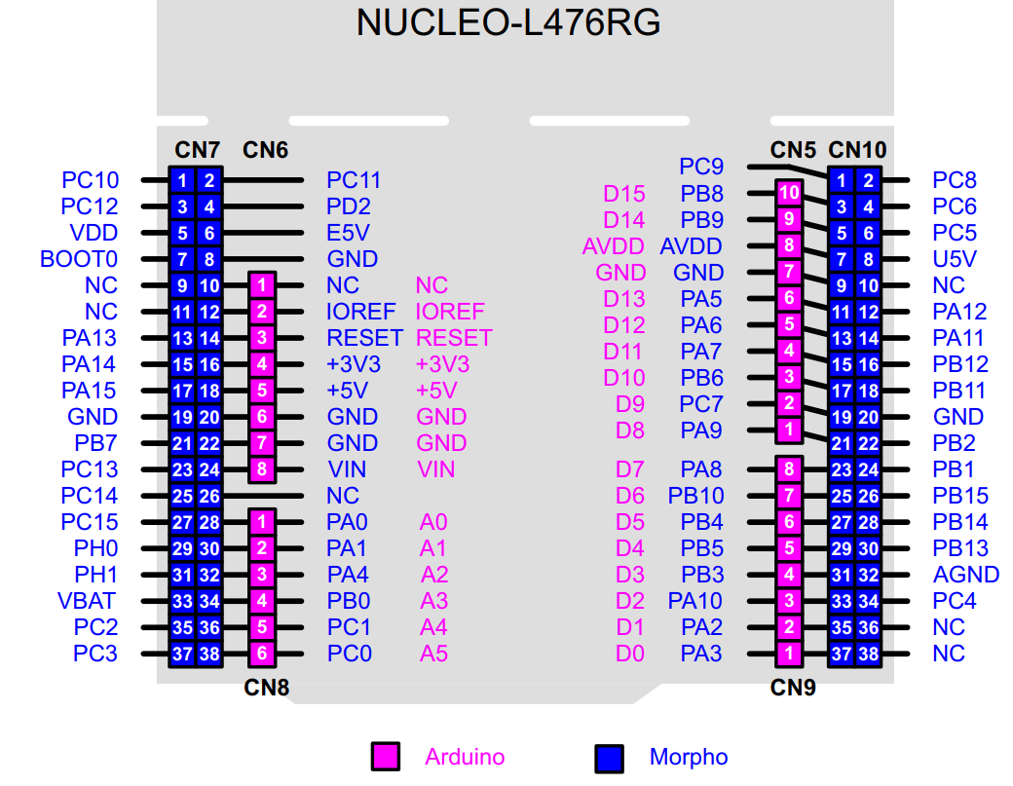
NUCLEO-L476RG . Pin Assignment

Slide 33
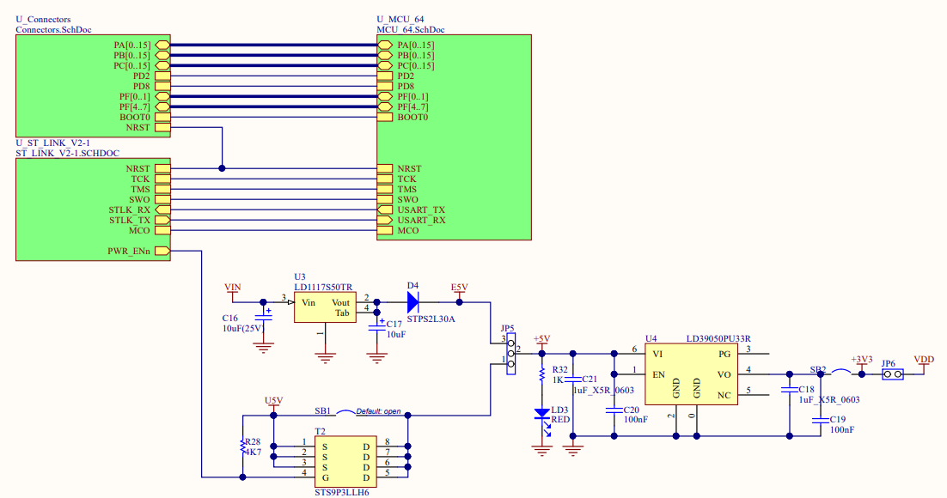
NUCLEO-L476RG . Schematic . Power

Slide 34
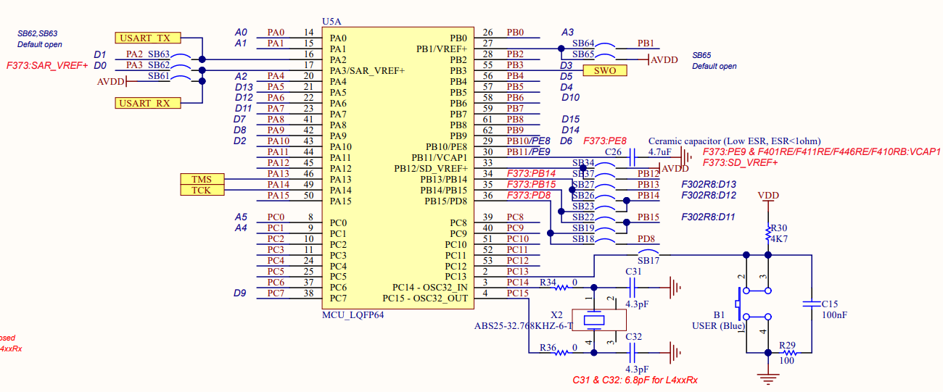
NUCLEO-L476RG . Schematic . MCU(STM32L469RGT6V)
USB(ST-Link)로 PC와 연결되어 있음
printf 사용

Slide 35
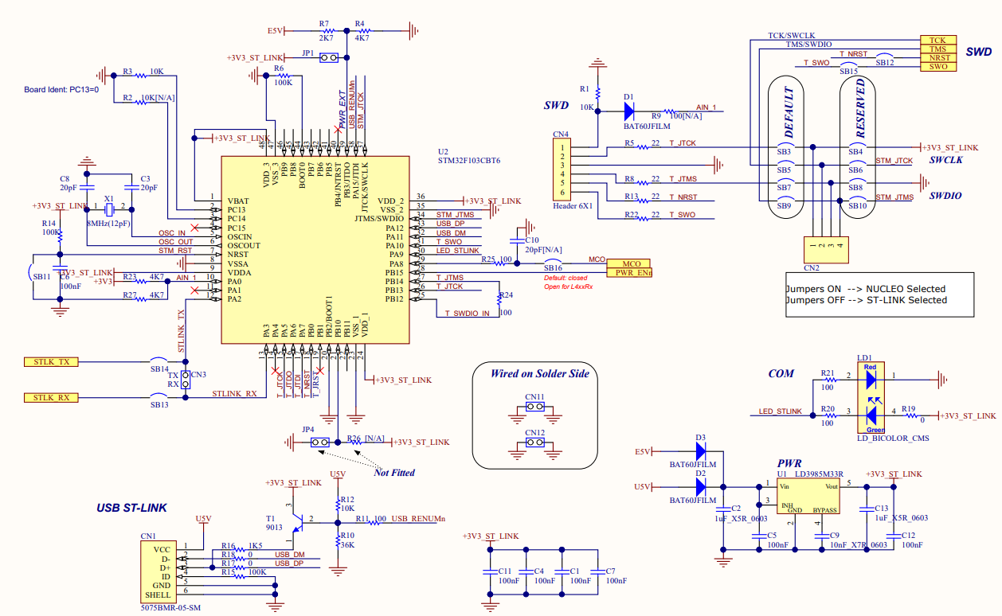
NUCLEO-L476RG . Schematic . ST-LINK

Slide 36
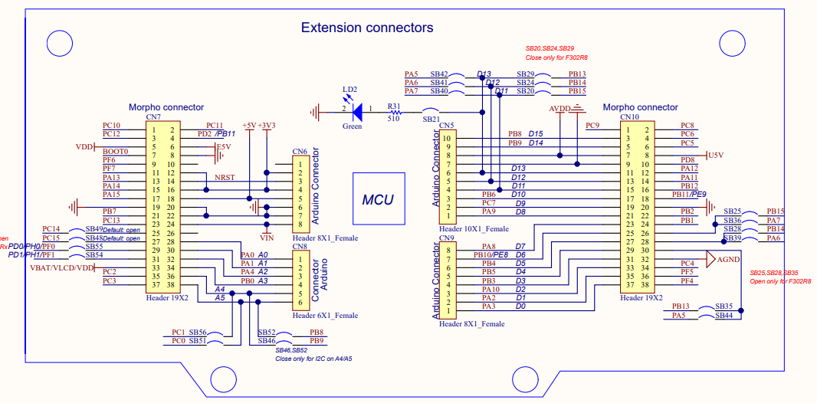
NUCLEO-L476RG . Schematic . Extension connectors

Slide 37
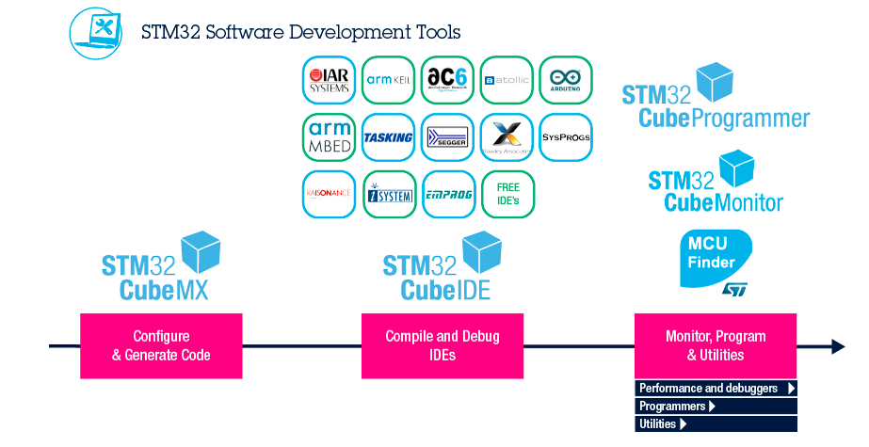
환경 설정 및 프로젝트 생성 도구
ST Software Development Tools

Slide 38
NUCLEO-L476RG CubeMx & CubeIDE
GPIO Control
General Purpose Input/Output
38

Slide 39
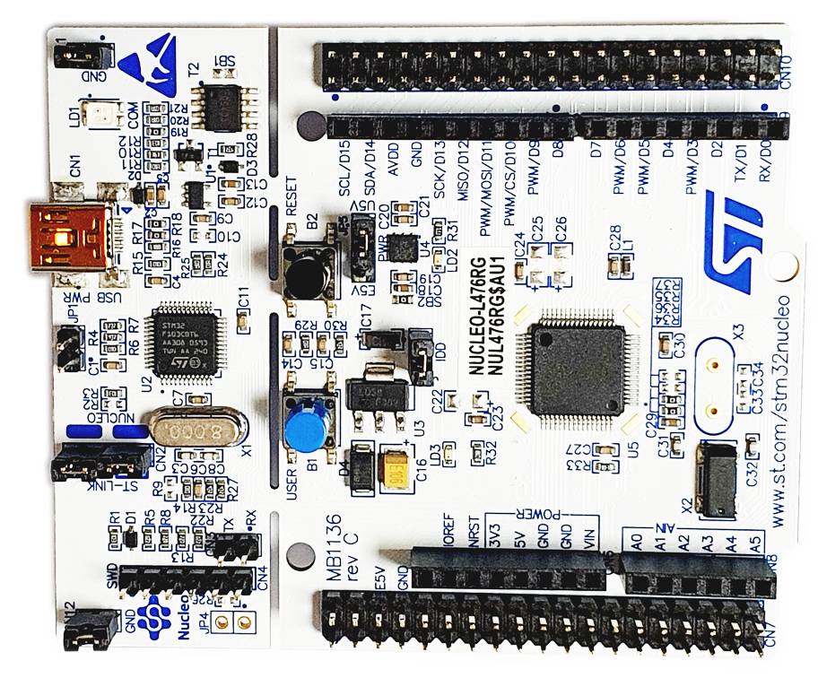
GPIO Control : 1. B1을 누르면 LD2 ON, 떼면 OFF
Output : LD2(PA5)
Input : B1 (PC13)

Slide 40
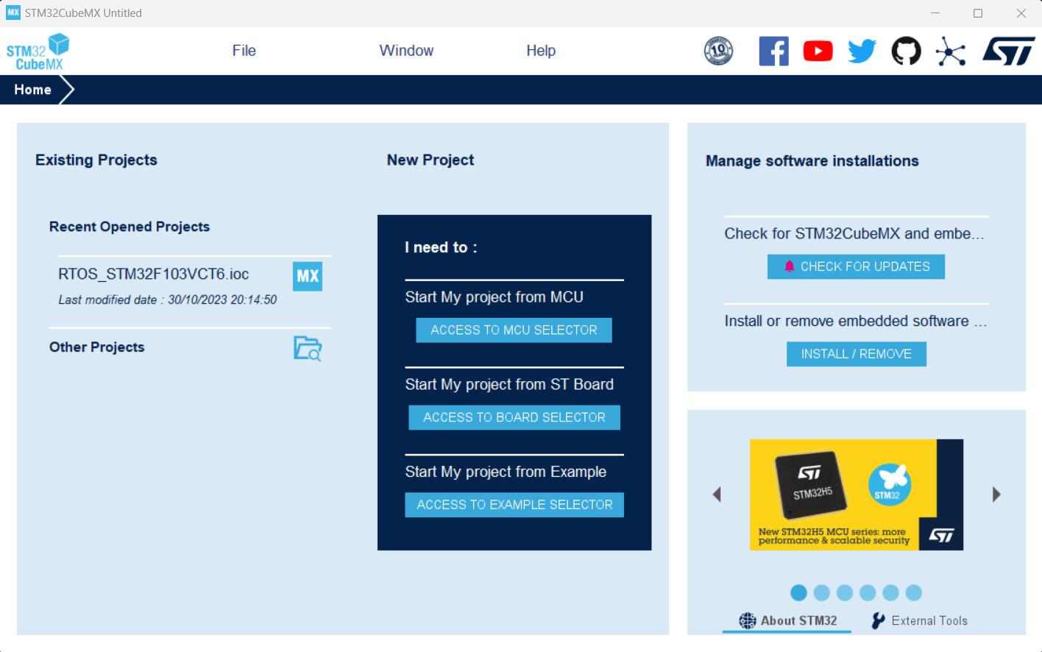
GPIO Control : 1. B1을 누르면 LD2 ON, 떼면 OFF : 1) CubeMx 설정
Click

Slide 41
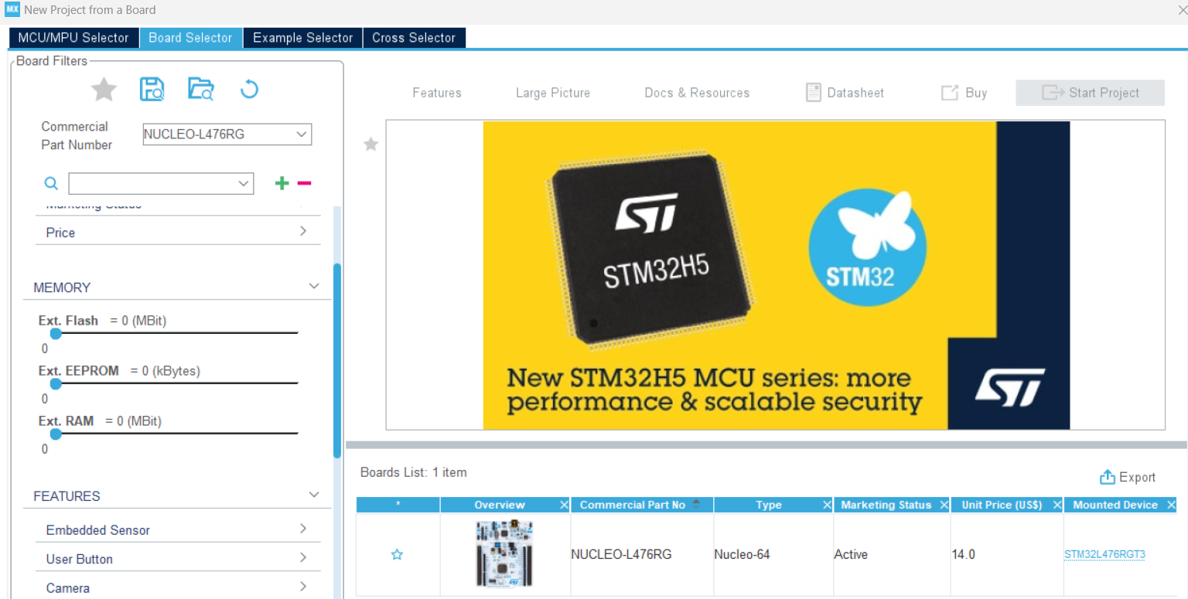
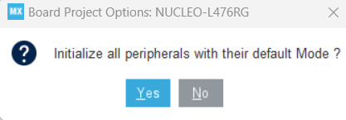
GPIO Control : 1. B1을 누르면 LD2 ON, 떼면 OFF : 1) CubeMx 설정
1
NUCLEO-L476RG
3
Double Click
2

Slide 42
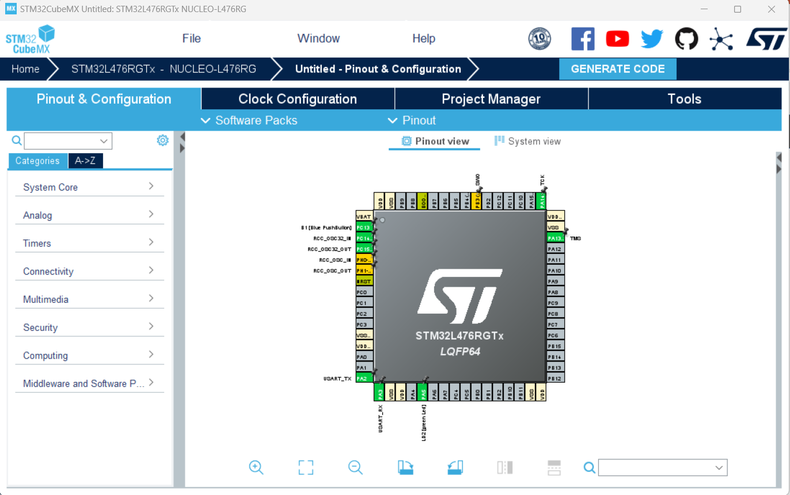
GPIO Control : 1. B1을 누르면 LD2 ON, 떼면 OFF : 1) CubeMx 설정
Clock, Pin 자동 설정되어 있음

Slide 43
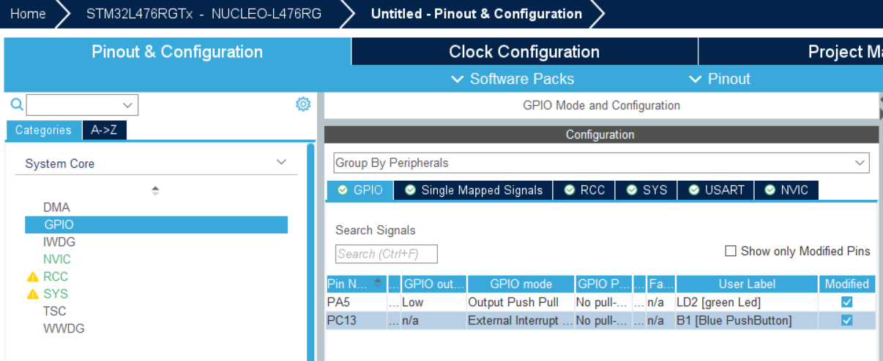
GPIO Control : 1. B1을 누르면 LD2 ON, 떼면 OFF : 1) CubeMx 설정
LED, Button Pin 설정되어 있음
PC13을 GPIO_Input 으로 설정 변경

Slide 44
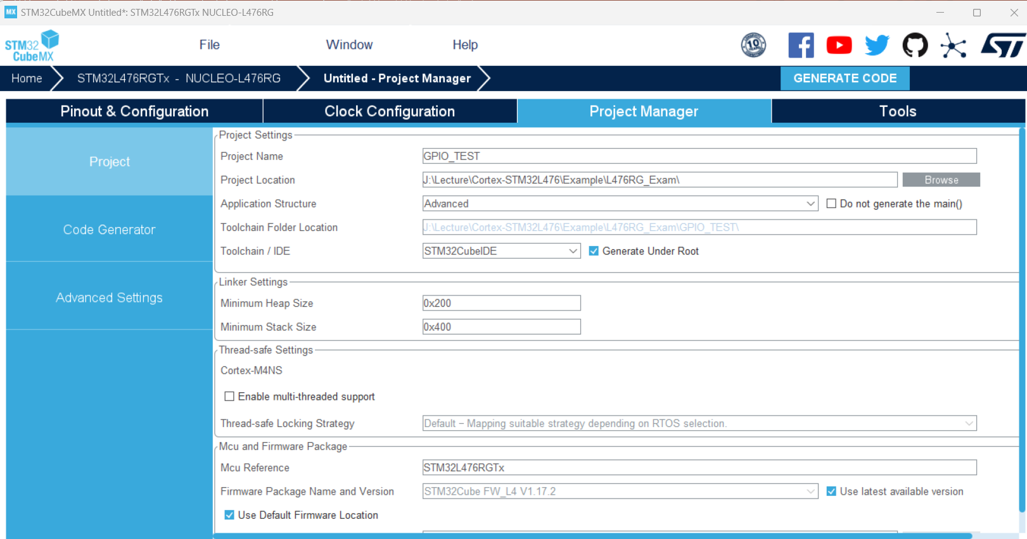
GPIO Control : 1. B1을 누르면 LD2 ON, 떼면 OFF : 1) CubeMx 설정
1
2
프로젝트 이름 입력
3
개발 환경은 STM32CubeIDE 선택

Slide 45
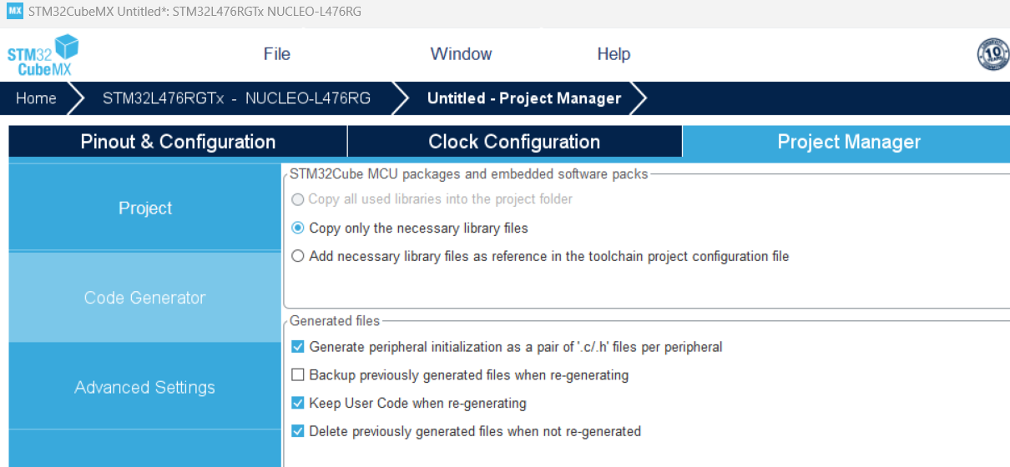
GPIO Control : 1. B1을 누르면 LD2 ON, 떼면 OFF : 1) CubeMx 설정
1
2
소스코드와 헤더파일을 다른 폴더에 저장

Slide 46
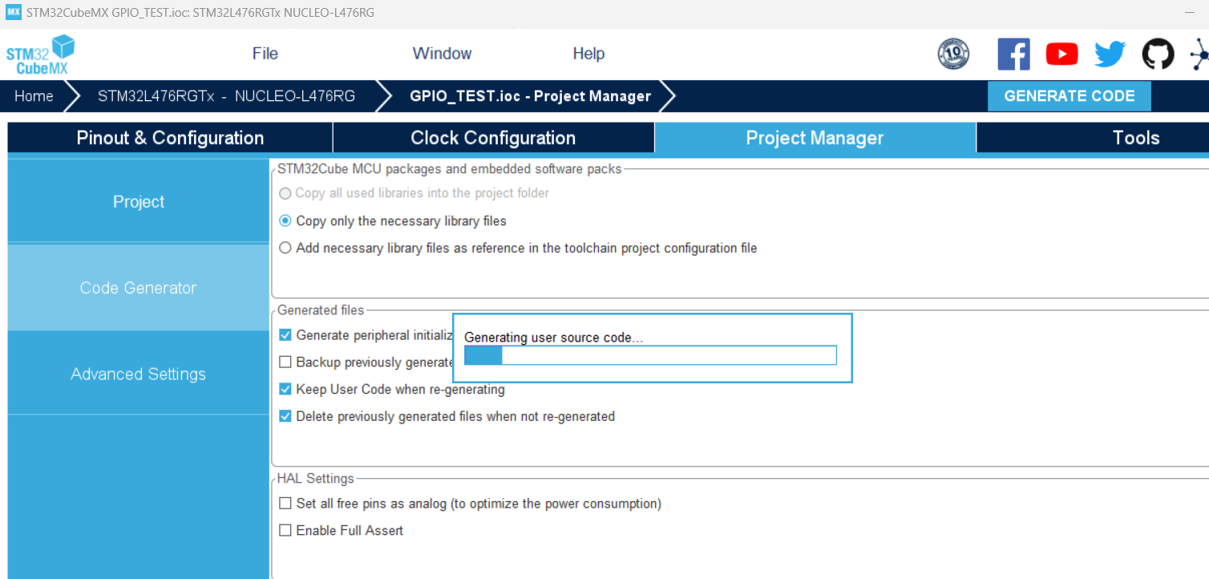
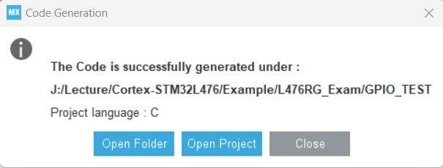
GPIO Control : 1. B1을 누르면 LD2 ON, 떼면 OFF : 1) CubeMx 설정
1
진행율 표시
2
3

Slide 47
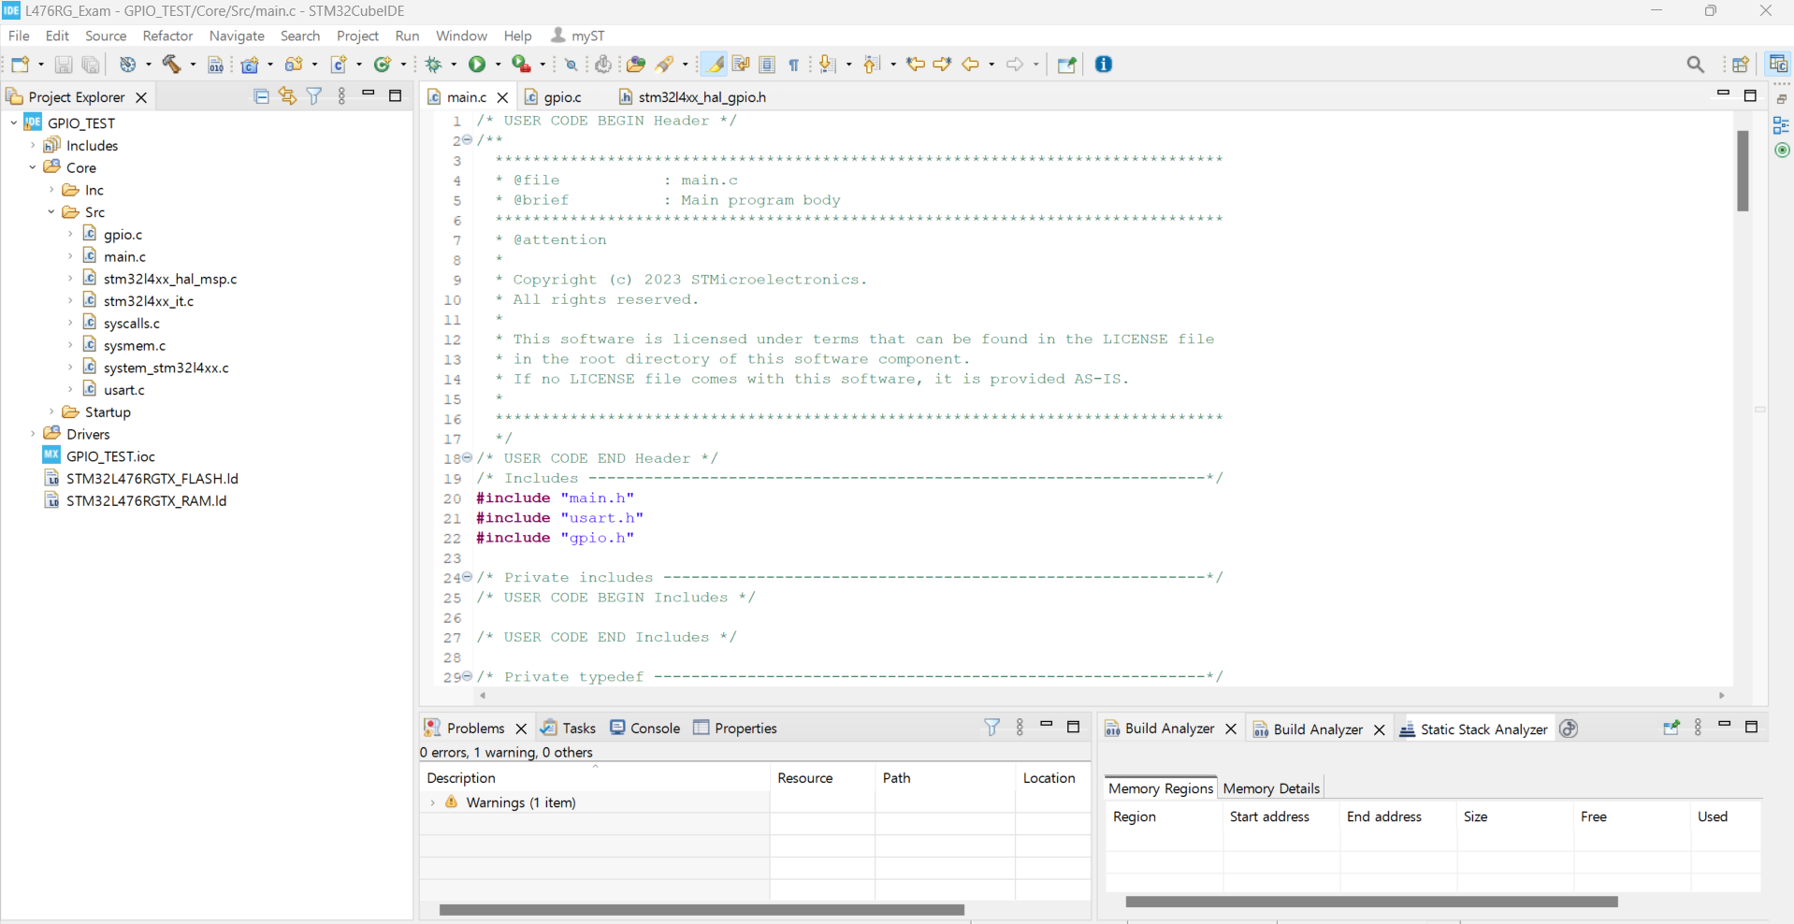
GPIO Control : 1. B1을 누르면 LD2 ON, 떼면 OFF : 2) CubeIDE

Slide 48
GPIO Control : 1. B1을 누르면 LD2 ON, 떼면 OFF : 2) CubeIDE – CODE 추가
int main(void)
{
/* Reset of all peripherals, Initializes the Flash interface and the Systick. */
HAL_Init();
/* USER CODE BEGIN Init */
/* USER CODE END Init */
/* Configure the system clock */
SystemClock_Config();
/* USER CODE BEGIN SysInit */
/* USER CODE END SysInit */
/* Initialize all configured peripherals */
MX_GPIO_Init();
MX_USART2_UART_Init();
/* USER CODE BEGIN 2 */
/* USER CODE END 2 */
/* Infinite loop */
/* USER CODE BEGIN WHILE */
while (1)
{
if(!(HAL_GPIO_ReadPin(GPIOC, GPIO_PIN_13)))
HAL_GPIO_WritePin(LD2_GPIO_Port, LD2_Pin, GPIO_PIN_SET);
else HAL_GPIO_WritePin(LD2_GPIO_Port, LD2_Pin, GPIO_PIN_RESET);
/* USER CODE END WHILE */
/* USER CODE BEGIN 3 */
}
/* USER CODE END 3 */
}

Slide 49
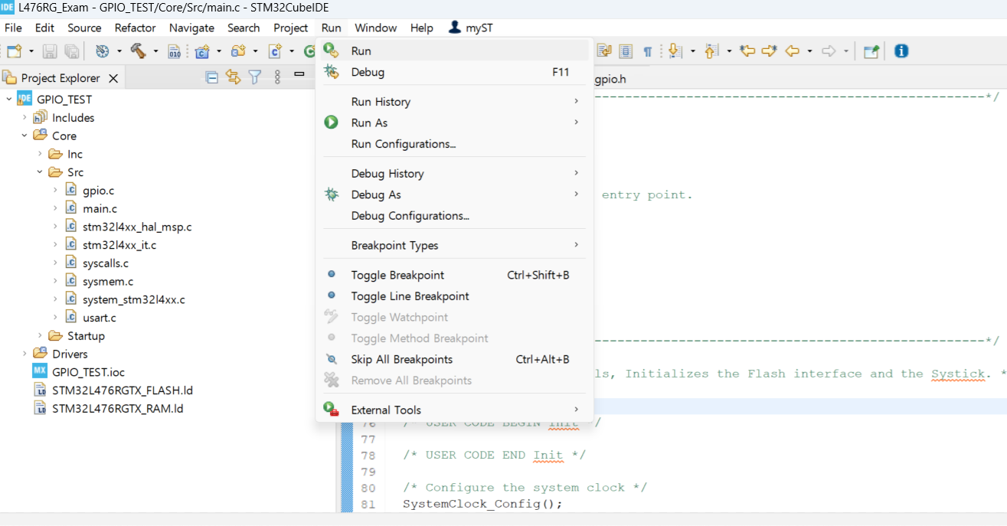
GPIO Control : 1. B1을 누르면 LD2 ON, 떼면 OFF : 2) CubeIDE – RUN

Slide 50
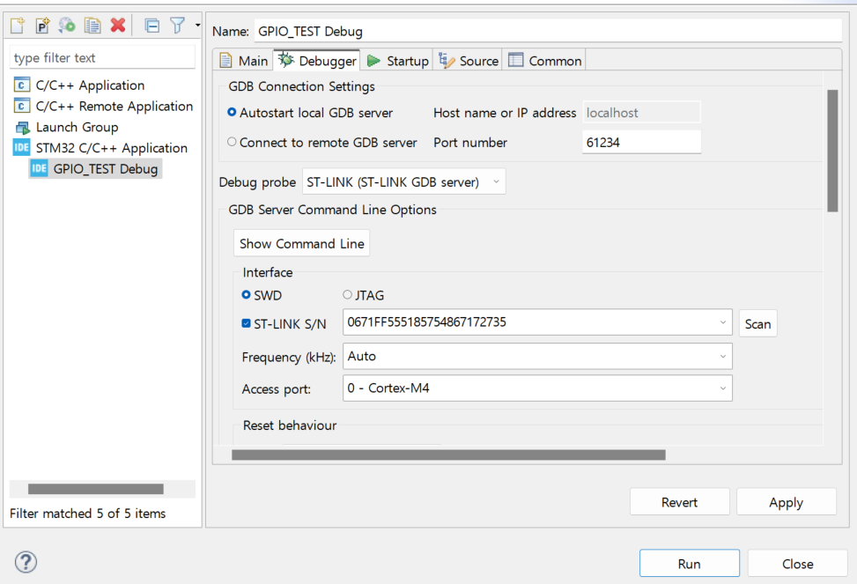
GPIO Control : 1. B1을 누르면 LD2 ON, 떼면 OFF : 2) CubeIDE – RUN
1
2
3

Slide 51
NUCLEO-L476RG
UART Serial Comm
UART 설정
printf 구현

Slide 52

UART : CubeMx 확인

Slide 53
UART : CubeIDE.printf()
#include <stdio.h> // 추가
// main 함수 바로 위에 아래 함수들 추가
int _write(int file, unsigned char* p, int len)
{
HAL_UART_Transmit(&huart2, p, len, 10);
return len;
}
#ifdef __GNUC__
#define PUTCHAR_PROTOTYPE int __io_putchar(int ch)
#else
#define PUTCHAR_PROTOTYPE int fputc(int ch, FILE *f) //for printf
#endif
PUTCHAR_PROTOTYPE
{
HAL_UART_Transmit(&huart2, (uint8_t *)&ch, 1, 0xFFFF);
return ch;
}
// main 함수 안에 한 줄 추가
MX_GPIO_Init();
MX_USART1_UART_Init();
/* USER CODE BEGIN 2 */
setvbuf(stdout, NULL, _IONBF, 0);

Slide 54

UART : CubeIDE.printf()
while (1)
{
if(!(HAL_GPIO_ReadPin(GPIOC, GPIO_PIN_13))){
if(!switchStatus)printf("Switch On.\r");
HAL_GPIO_WritePin(LD2_GPIO_Port, LD2_Pin, GPIO_PIN_SET);
switchStatus = 1;
}
else{
if(switchStatus)printf("Switch OFF\r");
HAL_GPIO_WritePin(LD2_GPIO_Port, LD2_Pin, GPIO_PIN_RESET);
switchStatus = 0;
}
/* USER CODE END WHILE */
/* USER CODE BEGIN 3 */
}

Slide 55
IoT RF Module Programmer

Slide 56






Block Diagram
3.3V
Single 1x5pin
straight(2.54mm)
R1608
ISP
Switch
USB
to
UART
커넥터
1
3.3V
100K
2
TX
1
2
3
4
5
6
7
8
9
10
20
19
18
17
16
15
14
13
12
11
IMMS-12V
3
RX
4
GND
GND
5
+5.0V
NC
molex 5267-05
핀헤더와 모렉스 커넥터 선택
사용할 수 있도록 병렬로 연결
1
3.3V
GND
Reset
ISP
RX
TX
GND
Reset
Button
USB
to
UART
커넥터
for
Cortex
2
3
Tact Switch
ITS-1105(5.0mm)-SMD
molex 5267-06
4
Single 1x6pin
straight(2.54mm)
5
6
CP2102 USB to TTL 컨버터 모듈
SZH-CVBE-012
2,400원

Slide 57

Schematic

Slide 58
PCB

Slide 59
LoRa & NUCLEO-L476RG
UART Serial Comm
UART 설정

Slide 60
실습 환경
End-Node
Coordinator
Sensors
Sensor Monitoring
&
Actuator
Control
UART
Actuator

Slide 61


sx1276 bin file
Lora.bin
Lora_RSSI.bin

Slide 62
LoRa module 연결 : UASRT1
PA9 : TX
PA10 : RX

Slide 63
LoRa module 연결 : UASRT1
1
2
3
4
5
6
7
8
9
10
왼쪽 밑에서 아홉번째 핀
왼쪽 밑에서 세번째 핀

Slide 64

CubeMx : UART1 설정

Slide 65
CubeIDE : USART 전역 변수 설정
USART Callback 함수가 있는 파일에서 전역 변수로 선언
uint8_t Rx1_Data[1], Rx2_Data[1];
uint8_t USART1_rx_end=0, USART2_rx_end=0;
uint8_t Rx1_Buffer[100], Rx2_Buffer[100];
uint8_t USART1_len=0, USART2_len=0;
USART Callback 함수 이외 파일에서 전역 변수 호출할 때.
extern uint8_t Rx1_Data[1], Rx2_Data[1];
extern uint8_t USART1_rx_end, USART2_rx_end;
extern uint8_t Rx1_Buffer[100], Rx2_Buffer[100];
extern uint8_t USART1_len, USART2_len;

Slide 66
Protocol
\x02ABCDEF\x03
\x02ABCDEF\x03
ABCDEF\x0a\x0d
\x02ABCDEF\x03

Slide 67
CubeIDE : UART2 추가 → Callback 함수 (1/2)
void HAL_UART_RxCpltCallback(UART_HandleTypeDef *huart)
{
static uint8_t usart2_chk=0;
if(huart -> Instance == USART1)
{
if(Rx1_Data[0]==0x0A){
USART1_rx_end=1;
}
else{
Rx1_Buffer[USART1_len]=Rx1_Data[0];
USART1_len++;
}
HAL_UART_Receive_IT(&huart1, Rx1_Data, 1);
}

Slide 68
else if(huart -> Instance == USART2){
USART2_rx_end=0;
switch(usart2_chk){
case 0:
if(Rx2_Data[0]==0x02){
Rx2_Buffer[USART2_len]=Rx2_Data[0];
USART2_len++;
usart2_chk=1;
}
else usart2_chk=0;
break;
case 1:
if(Rx2_Data[0]==0x03){
Rx2_Buffer[USART2_len]=Rx2_Data[0];
USART2_len++;
USART2_rx_end=1;
usart2_chk=0;
}
else{
Rx2_Buffer[USART2_len]=Rx2_Data[0];
USART2_len++;
}
break;
default :
usart2_chk=0;
break;
}
HAL_UART_Receive_IT(&huart2, Rx2_Data, 1);
}
}
CubeIDE : UART2 추가 → Callback 함수 (2/2)
USART2에 대한
Callback 함수 작성

Slide 69
Coordinator → End Node
Data 전송
PC
SerialPortMon
Transfer datas
PC
SerialPortMon
Receive datas
USART1
USART2

Slide 70
// printf 문을 USART1, USART2 모두 사용할 수 있도록 아래와 같이 수정하자.
uint8_t Printf_Mode=2;
int _write(int file, unsigned char* p, int len)
{
if(Printf_Mode==1)HAL_UART_Transmit(&huart1, p, len, 10);
else if(Printf_Mode==2)HAL_UART_Transmit(&huart2, p, len, 10);
return len;
}
#ifdef __GNUC__
#define PUTCHAR_PROTOTYPE int __io_putchar(int ch)
#else
#define PUTCHAR_PROTOTYPE int fputc(int ch, FILE *f) //for printf
#endif
PUTCHAR_PROTOTYPE
{
if(Printf_Mode==1)HAL_UART_Transmit(&huart1, (uint8_t *)&ch, 1, 0xFFFF);
else if(Printf_Mode==2)HAL_UART_Transmit(&huart2, (uint8_t *)&ch, 1, 0xFFFF);
return ch;
}
CubeIDE.Code

Slide 71
// main함수
while (1)
{
if(USART1_rx_end){ // from RF Module
printf("RF received data = %s",Rx1_Buffer);
USART1_rx_end = 0;
USART1_len = 0;
}
if(USART2_rx_end){ // from PC
Printf_Mode=1;
// PC에서 입력된 값을 USART1 RF
for(i=0; i<USART2_len; i++)printf("%d", Rx2_Buffer[i]);
Printf_Mode=2;
USART2_rx_end = 0;
USART2_len = 0;
}
}
CubeIDE.Code

Slide 72



DHT11 온/습도 데이터 전송
EndNode → Coordinator

Slide 73

Connection
PC3

Slide 74

CubeMx 설정
PC3 GPIO_Input 으로 설정
Timer6 → DHT11 delay()함수 만들기 위해 사용 (NVIC 설정은 하지 않음)

Slide 75
#include "dht11.h"
extern TIM_HandleTypeDef htim6;
DHT_DataTypedef DHT11_Data;
uint8_t Rh_byte1, Rh_byte2, Temp_byte1, Temp_byte2;
uint16_t SUM; uint8_t Presence = 0;
void Set_Pin_Output (GPIO_TypeDef *GPIOx, uint16_t GPIO_Pin)
{
GPIO_InitTypeDef GPIO_InitStruct = {0};
GPIO_InitStruct.Pin = GPIO_Pin;
GPIO_InitStruct.Mode = GPIO_MODE_OUTPUT_PP;
GPIO_InitStruct.Speed = GPIO_SPEED_FREQ_LOW;
HAL_GPIO_Init(GPIOx, &GPIO_InitStruct);
}
void Set_Pin_Input (GPIO_TypeDef *GPIOx, uint16_t GPIO_Pin)
{
GPIO_InitTypeDef GPIO_InitStruct = {0};
GPIO_InitStruct.Pin = GPIO_Pin;
GPIO_InitStruct.Mode = GPIO_MODE_INPUT;
GPIO_InitStruct.Pull = GPIO_NOPULL;
HAL_GPIO_Init(GPIOx, &GPIO_InitStruct);
}
CubeIDE → dht11.c (1/4)
DHT11 Signal 핀은
Input, Output 2가지 용도로
사용되므로 핀 기능을
변경해주는 함수 필요

Slide 76
void delay (uint16_t us)
{
__HAL_TIM_SET_COUNTER(&htim6,0); // set the counter value a 0
while (__HAL_TIM_GET_COUNTER(&htim6) < us);
}
void DHT11_START(){
Set_Pin_Output (DHT11_PORT, DHT11_PIN); // set the pin as output
HAL_GPIO_WritePin (DHT11_PORT, DHT11_PIN, 0); // pull the pin low
delay (18000); // wait for 18ms
Set_Pin_Input(DHT11_PORT, DHT11_PIN); // set as input
}
uint8_t Check_Response (void)
{
uint8_t Response = 0;
delay (40);
if (!(HAL_GPIO_ReadPin (DHT11_PORT, DHT11_PIN))){
delay (80);
if ((HAL_GPIO_ReadPin (DHT11_PORT, DHT11_PIN))) Response = 1;
else Response = -1;
}
while ((HAL_GPIO_ReadPin (DHT11_PORT, DHT11_PIN))); // wait for the pin to go low
return Response;
}
CubeIDE → dht11.c (2/4)

Slide 77
CubeIDE → dht11.c (3/4)
uint8_t DHT11_Read (void)
{
uint8_t i,j;
for (j=0;j<8;j++){
while (!(HAL_GPIO_ReadPin (DHT11_PORT, DHT11_PIN))); // wait pin to go high
delay (40); // wait for 40 us
if (!(HAL_GPIO_ReadPin (DHT11_PORT, DHT11_PIN))){ // if the pin is low
i&= ~(1<<(7-j)); // write 0
}
else i|= (1<<(7-j)); // if the pin is high, write 1
while ((HAL_GPIO_ReadPin (DHT11_PORT, DHT11_PIN))); // wait the pin to go low
}
return i;
}

Slide 78
CubeIDE → dht11.c (4/4)
void DHT_GetData (DHT_DataTypedef *DHT_Data)
{
DHT11_START();
Presence = Check_Response ();
Rh_byte1 = DHT11_Read ();
Rh_byte2 = DHT11_Read ();
Temp_byte1 = DHT11_Read ();
Temp_byte2 = DHT11_Read ();
SUM = DHT11_Read();
if (SUM == (Rh_byte1+Rh_byte2+Temp_byte1+Temp_byte2)){
DHT_Data->Temperature = (Temp_byte1+(Temp_byte2*0.1));
DHT_Data->Humidity = Rh_byte1;
}
}

Slide 79
CubeIDE → dht11.h (1/1)
#include "main.h"
#define DHT11_PORT GPIOC
#define DHT11_PIN GPIO_PIN_3
typedef struct
{
float Temperature;
float Humidity;
}DHT_DataTypedef;
void DHT_GetData (DHT_DataTypedef *DHT_Data);

Slide 80

#include "dht11.h“
~~~
// 전역변수 선언
extern DHT_DataTypedef DHT11_Data;
float Temperature;
float Humidity;
~~~
int main(void)
{
~~~
HAL_TIM_Base_Start_IT(&htim6); ~~~
while (1)
{
// for DHT11
DHT_GetData(&DHT11_Data);
Temperature = DHT11_Data.Temperature;
Humidity = DHT11_Data.Humidity;
printf(“T=%.1f, Humi=%.1f\n",Temperature,Humidity);
HAL_Delay(3000);
}
/* USER CODE END 3 */
}
CubeIDE → main.c

Slide 81
여기까지는 DHT11 온/습도 읽는 것까지.
RF 전송을 위해서 printf 문을 USART1, USART2모두 사용할 수 있도록 설정해보자.

Slide 82
CubeIDE (1/2)
Printf_Mode 전역 변수 선언
int _write(int file, unsigned char* p, int len)
{
if(Printf_Mode==1)HAL_UART_Transmit(&huart1, p, len, 10);
else if(Printf_Mode==2)HAL_UART_Transmit(&huart2, p, len, 10);
return len;
}
#ifdef __GNUC__
#define PUTCHAR_PROTOTYPE int __io_putchar(int ch)
#else
#define PUTCHAR_PROTOTYPE int fputc(int ch, FILE *f) //for printf
#endif
PUTCHAR_PROTOTYPE
{
if(Printf_Mode==1)HAL_UART_Transmit(&huart1, (uint8_t *)&ch, 1, 0xFFFF);
else if(Printf_Mode==2)HAL_UART_Transmit(&huart2, (uint8_t *)&ch, 1, 0xFFFF);
return ch;
}

Slide 83
CubeIDE (2/2)
while (1)
{
if(USART1_rx_end){
printf("RF received data = %s", Rx1_Buffer);
USART1_rx_end = 0;
USART1_len = 0;
}
DHT_GetData(&DHT11_Data);
Temperature = DHT11_Data.Temperature;
Humidity = DHT11_Data.Humidity;
printf("T=%.1f,H=%.1f\n",Temperature,Humidity);
Printf_Mode=1;
printf("\x02T=%.1f,H=%.1f\x03",Temperature,Humidity);
Printf_Mode=2;
HAL_Delay(3000);
}

Slide 84

동작 확인
End Node
Coordinater

Slide 85

원격 RGB LED Control
Coordinator → End Node

Slide 86

CubeMx 설정 . LED 설정
LED
B
G
R
DHT11

Slide 87


CubeMx 설정 → 100usec Timer4 설정 → PWM LED 제어용으로 사용
100Hz(100usec) Timer 만들기
Case of APB1 Timer clocks = 80MHz
$\frac{1}{0.0001} =\frac{ 80,000,000}{(Prescaler ∗Counter Period)}$
$=\frac{ 80,000,000}{(800 ∗ 10)}$
Prescaler = 799
Counter Period = 10

Slide 88
CubeIDE . Timer4 callback 함수
uint8_t Timer_R=0, Timer_G=0, Timer_B=0;
extern uint8_t PWM_R, PWM_G, PWM_B;
void HAL_TIM_PeriodElapsedCallback(TIM_HandleTypeDef *htim)
{
if(htim -> Instance == TIM4){
Timer_R++;
if(PWM_R > Timer_R)HAL_GPIO_WritePin(GPIOB, GPIO_PIN_13, GPIO_PIN_SET);
else HAL_GPIO_WritePin(GPIOB, GPIO_PIN_13, GPIO_PIN_RESET);
if(Timer_R >= 100)Timer_R = 0;
Timer_G++;
if(PWM_G > Timer_G)HAL_GPIO_WritePin(GPIOB, GPIO_PIN_14, GPIO_PIN_SET);
else HAL_GPIO_WritePin(GPIOB, GPIO_PIN_14, GPIO_PIN_RESET);
if(Timer_G >= 100)Timer_G = 0;
Timer_B++;
if(PWM_B > Timer_B)HAL_GPIO_WritePin(GPIOB, GPIO_PIN_15, GPIO_PIN_SET);
else HAL_GPIO_WritePin(GPIOB, GPIO_PIN_15, GPIO_PIN_RESET);
if(Timer_B >= 100)Timer_B = 0;
}
}

Slide 89
CubeIDE . main 함수 LED PWM Test
HAL_TIM_Base_Start_IT(&htim4);
printf("Start Program.\n");
/* USER CODE END 2 */
/* Infinite loop */
/* USER CODE BEGIN WHILE */
while (1)
{
for(i=0; i<=10; i++){
PWM_R=10*i;
HAL_Delay(1000);
}
}
LED가 10%씩 밝아지는 것을 확인할 수 있다.

Slide 90

CubeIDE . main 함수 LED PWM Test
PyQt Program
USART1
\x02RxxxGxxxBxxx\x03

Slide 91




PyQt.Designer . rgb_gui.ui
Widget → Horizontal Scroll Bar
0~100사이 설정
scroll bar를 조절하면,
label에 값이 표시되도록 구현
Style sheet
background-color:rgb(255, 0, 0);
background-color:rgb(0, 255, 0);
background-color:rgb(0, 0, 255);
label
push button

Slide 92
MCU → Firmware
while (1)
{
// if RF Received
if(USART1_rx_end)
{
printf("RF received data = %s", Rx1_Buffer);
PWM_R = ((Rx1_Buffer[1]-'0')*100)+((Rx1_Buffer[2]-'0')*10)+(Rx1_Buffer[3]-'0');
PWM_G = ((Rx1_Buffer[5]-'0')*100)+((Rx1_Buffer[6]-'0')*10)+(Rx1_Buffer[7]-'0');
PWM_B = ((Rx1_Buffer[9]-'0')*100)+((Rx1_Buffer[10]-'0')*10)+(Rx1_Buffer[11]- '0');
printf("PWM_R=%d,PWM_G=%d, PWM_B=%d", PWM_R,PWM_G,PWM_B);
USART1_rx_end = 0;
USART1_len = 0;
}

Slide 93
rgb_run.py (1/3)
import serial
from rgb_gui import *
import threading
import sys
from time import sleep
ser = serial.Serial(port='COM4',
baudrate=115200,
parity=serial.PARITY_NONE,
stopbits=serial.STOPBITS_ONE,
bytesize=serial.EIGHTBITS,
timeout=1)
# 인코딩 설정 변경하기
def receiveData(self, ui):
while True:
rxdata = ser.readline().decode('utf-8')
if rxdata :
print(rxdata)

Slide 94

def signals(self):
self.SEND.clicked.connect(self.sendData)
self.EXIT.clicked.connect(lambda:sys.exit(app.exec_()))
def receiveData(self, ui):
while True:
rxdata = ser.readline().decode('utf-8')
if rxdata :
print(rxdata)
def sendData(self):
R=int(self.R.text()); G=int(self.G.text()); B=int(self.B.text())
R=format(R, '03'); G=format(G, '03'); B=format(B, '03')
R=str(R); G=str(G); B=str(B)
message = ''.join(['\x02','R',R,'G',G,'B',B,'\x03'])
ser.write(bytes(message.encode()))
print(message)
rgb_run.py (2/3)
MCU에서 Parcing을 용이하게 하기 위해
dimming 자릿수를 3자리로 고정
ex) 35 → 035

Slide 95
Ui_MainWindow.signals = signals
Ui_MainWindow.sendData = sendData
if __name__=='__main__':
app = QtWidgets.QApplication(sys.argv)
MainWindow = QtWidgets.QMainWindow()
ui = Ui_MainWindow(); ui.setupUi(MainWindow)
ui.signals()
thread = threading.Thread(target=receiveData, args=(ser,ui))
thread.daemon = True; thread.start()
MainWindow.show()
sys.exit(app.exec_())
rgb_run.py (3/3)

Slide 96

동작 시험
RGB Dimming 값을 조절하여
색을 조합하여 표현할 수 있다.

Slide 97
동일 Channel을 사용하면 다른 RF 단말기 데이터 수신
자신만의 단말기 4자리 ID를 부여하자
기존 → \x02RxxxGxxxBxxx\x03
변경 → \x02IDxxRxxxGxxxBxxx\x03 xx 에 자기 번호 입력

Slide 98
High Power 부하 PWM 제어

Slide 99

실험 환경. L298n PWM Motor Driver
+
-
Power
Supply
+12V
GND
MCU
IN1
PB6.PWM
IN2
GND
UART
RF Module
부하 용량을 정확히 확인 !!!
정격 전압, 전류
P = I x V [W]

Slide 100

실험 환경. L298n PWM Motor Driver
ENA: Enable 단자 그냥 두어도 됨
12V만 인가하여도 보드 내부 Regulator에서 5V 만듦
L298n Motor driver Arduino | Motors | Motor Driver | L298n | Arduino Project Hub

Slide 101

실험 환경. L298n PWM Motor Driver. Schematic
Motor Driver Module-L298N - Wiki (sunfounder.cc)

Slide 102

다수 조명을 동시 제어해 보자

Slide 103

원격 조명 제어 응용 분야 – 야외 축구장 조명 제어
1
1
1
무선 투광등 제어 보드 : 8 set
2
무선 투광등 관리 보드 : 1 set
1
1
2
1
1
1
1

Slide 104



Block diagram
MCU
STM32F101
RGB
LED
조명
PWM
MOS
FET
R
RF
Module
UART
DC12~24V
RGB LED
PWM
MOS
FET
G
PWM
MOS
FET
B
AC 220V White
150W LED
PWM
Photo
coupler
W
SMPS
PWM
DC12V
AC220V

Slide 105

RF Control PCB Schematic (1/2)
RF Module
LoRa
Zigbee
900MHz

Slide 106

RF Control PCB Schematic (2/2)
To Red LED
To Green LED
To Blue LED
To White LED

Slide 107

PCB Artwork

Slide 108

Power MOSFET

Slide 109

PyQt → Designer.TenCH_gui.ui
push button
1번 → ID01
Horizontal
Scrollbar
0~255
push button
Line edit
조명 별명 입력→ 전송되지는 않음

Slide 110
import serial
from TenCH_led_gui import *
import threading
import sys
from time import sleep ser = serial.Serial(port='COM4',
baudrate=115200,
parity=serial.PARITY_NONE,
stopbits=serial.STOPBITS_ONE,
bytesize=serial.EIGHTBITS,
timeout=1)
def signals(self):
pushButton_list =[self.pushButton1, self.pushButton2, self.pushButton3,
self.pushButton4, self.pushButton5, self.pushButton6, self.pushButton7,
self.pushButton8, self.pushButton9, self.pushButton10]
for pushButton in pushButton_list:
pushButton.setStyleSheet(stylesheet_1)
self.SEND.setStyleSheet(stylesheet_2)
self.EXIT.setStyleSheet(stylesheet_2)
self.SEND.clicked.connect(self.sendData)
self.EXIT.clicked.connect(lambda:sys.exit(app.exec_()))
PyQt → TenCH_led_run.py (1/3)

Slide 111
PyQt → TenCH_led_run.py (2/3)
def sendData(self):
pushButton_list =[self.pushButton1, self.pushButton2, self.pushButton3,
self.pushButton4, self.pushButton5, self.pushButton6, self.pushButton7,
self.pushButton8, self.pushButton9, self.pushButton10]
for pushButton in pushButton_list:
if pushButton.isChecked():
ID=str(int(pushButton.text())+100)[1:]
W=str(int(self.W.text())+1000)[1:]
R=str(int(self.R.text())+1000)[1:]
G=str(int(self.G.text())+1000)[1:]
B=str(int(self.B.text())+1000)[1:]
message = ''.join(['\x02','L',ID,'W',W,'R',R,'G',G,'B',B,'\x0d\x0a\x03'])
ser.write(bytes(message.encode()))
print(message)
sleep(0.4)

Slide 112
PyQt → TenCH_led_run.py (3/3)
stylesheet_1 = 'QPushButton{border: 2px solid rgba(255, 180, 0);border-radius:5px;}' \
+'QPushButton:checked{border: 2px solid rgba(255, 180, 0);' \
+'background-color:qlineargradient(spread:reflect, x1:0.483889, y1:0, x2:0.500333, y2:0.512,' \
+'stop:0 rgba(255, 180, 0, 255), stop:1 rgba(255, 229, 44, 255));' \
+'border-radius:5px;}'
stylesheet_2 = 'QPushButton{border: 2px solid rgba(255, 180, 0);border-radius:5px;}' \
+'QPushButton:pressed{border: 2px solid rgba(255, 180, 0);' \
+'background-color:qlineargradient(spread:reflect, x1:0.483889, y1:0, x2:0.500333, y2:0.512,' \
+'stop:0 rgba(255, 180, 0, 255), stop:1 rgba(255, 229, 44, 255));' \
+'border-radius:5px;}‘
Ui_MainWindow.signals = signals
Ui_MainWindow.sendData = sendData
if __name__=='__main__':
app = QtWidgets.QApplication(sys.argv)
MainWindow = QtWidgets.QMainWindow()
ui = Ui_MainWindow()
ui.setupUi(MainWindow)
ui.signals()
MainWindow.show()
sys.exit(app.exec_())

Slide 113
MCU Firmware를 설계해 보자

Slide 114
LED Control Module. Firmware
1. 전역 변수 선언
extern UCHAR Buffer_USART1[100];
extern UCHAR USART1_rx_end, USART1_len;
extern UCHAR Buffer_USART2[100];
extern UCHAR USART2_rx_end, USART2_len;
u8 Flash_Buf[128]={0x30}; // 최종 설정 Dimming 저장
u16 Dim=4095;
u8 Controller_ID=1;
u8 DIM_R=0, DIM_G=0, DIM_B=0;

Slide 115
LED Control Module. Firmware
2. RF 수신 함수
void Check_RFcommand(void)
{
if(USART2_rx_end){
USART2_rx_end=0;
USART1_printf(USART1, "\n Received something.");
if(Buffer_USART2[2]-0x30 == Controller_ID){
Dim = (u16)(((Buffer_USART2[4]-0x30)*100 + (Buffer_USART2[5]-0x30)*10 + (Buffer_USART2[6]-0x30))*40.95);
Dim = 4096-Dim; // TR Inverting
printf("\n Dim : %d" ,Dim);
Control_LEDDIM();
DIM_R= ((Buffer_USART2[8]-0x30)*100 + (Buffer_USART2[9]-0x30)*10 + (Buffer_USART2[10]-0x30));
DIM_R = (u8)(DIM_R/2.5);
if(DIM_R > 100)DIM_R=100;
printf(USART1,"\n Dim R = %d" ,DIM_R);
DIM_G= ((Buffer_USART2[12]-0x30)*100 + (Buffer_USART2[13]-0x30)*10 + (Buffer_USART2[14]-0x30));
DIM_G = (u8)(DIM_G/2.5);
if(DIM_G > 100)DIM_G=100;
printf(USART1,"\n Dim G = %d" ,DIM_G);
DIM_B= ((Buffer_USART2[16]-0x30)*100 + (Buffer_USART2[17]-0x30)*10 + (Buffer_USART2[18]-0x30));
DIM_B = (u8)(DIM_B/2.5);
if(DIM_B > 100)DIM_B=100;
printf("\n Dim B = %d" ,DIM_B);
Send_OKtoSmartPhone();
}
}
}

Slide 116
LED Control Module. Firmware
3. LED Control 함수
void Control_LEDDIM(void)
{
Timer2_Init(); //PWM Generation of R1, R2
Timer3_Init(); //PWM Generation of R3, R4
}

Slide 117
LED Control Module. Firmware
3. LED Control 함수
void Timer3_Init(void)
{
TIM_TimeBaseInitTypeDef TIM_TimeBaseStructure;
TIM_OCInitTypeDef TIM_OCInitStructure;
TIM_TimeBaseStructure.TIM_Prescaler = 34;
TIM_TimeBaseStructure.TIM_CounterMode = TIM_CounterMode_Up;
TIM_TimeBaseStructure.TIM_Period = 4095;
TIM_TimeBaseStructure.TIM_ClockDivision = 0;
TIM_TimeBaseStructure.TIM_RepetitionCounter = 0;
TIM_TimeBaseInit(TIM3, &TIM_TimeBaseStructure); // Channel 1, 2,3 and 4 Configuration in PWM mode
TIM_OCInitStructure.TIM_OCMode = TIM_OCMode_PWM2;
TIM_OCInitStructure.TIM_OutputState = TIM_OutputState_Enable;
TIM_OCInitStructure.TIM_OutputNState = TIM_OutputNState_Enable;
TIM_OCInitStructure.TIM_Pulse = Dim;
TIM_OCInitStructure.TIM_OCPolarity = TIM_OCPolarity_Low;
TIM_OCInitStructure.TIM_OCNPolarity = TIM_OCNPolarity_High;
TIM_OCInitStructure.TIM_OCIdleState = TIM_OCIdleState_Set;
TIM_OCInitStructure.TIM_OCNIdleState = TIM_OCIdleState_Reset;

Slide 118
LED Control Module. Firmware
3. LED Control 함수
void TIM2_IRQHandler(void)
{
TIM_ClearITPendingBit(TIM2, TIM_IT_Update);
Timer2_R++; Timer2_G++; Timer2_B++;
if(DIM_R==100){
Timer2_R=0;
LED_R_ON;
}
else if(DIM_R==0){
Timer2_R=0;
LED_R_OFF;
}
else {
if(Timer2_R > DIM_R) {
LED_R_OFF;
}
if(Timer2_R >= 100) {
LED_R_ON;
Timer2_R=0;
}
} if(DIM_G==100){

Slide 119
2개 RF Module을 이용한
원격 제어

Slide 120



2개 RF Module을 이용한 원격 제어
CdS 조도에 따른 조명 자동 밝기 조절
CdS 연결
STM32F469I-DISCO
UART
UART6
RF

Slide 121

2개 RF Module을 이용한 원격 제어
STM32F469I-DISCO
CubeMx에서 USART6 Tx,Rx가 PC6, PC7로 설정되어 있는지 확인 !!!

Slide 122

2개 RF Module을 이용한 원격 제어
STM32F469I-DISCO
CdS 연결
S | A0-PB1
가운데 핀 | +3.3V
- | GND

Slide 123
AC 전원 제어

Slide 124


AC 기기 제어 → Relay
5V Single-Channel Relay Module - Pin Diagram, Specifications, Applications, Working (components101.com)

Slide 125


AC 기기 제어 → SSR
1pc SSR-10DA 10A solid state relay 3-32VDC/90-380VAC | eBay

Slide 126
AC 기기 제어 → 회로 구성
220V 부하
UART

Slide 127
SX1276 LoRa 모듈 개발
with STM32L073

Slide 128

목 차
Datasheet
PCB Schematic
CubeMX Setting
Source code download
Protocol Description
F/W Programming

Slide 129
1. Datasheet
https://www.st.com/resource/en/datasheet/stm32l073rz.pdf
https://semtech.my.salesforce.com/sfc/p/E0000000JelG/a/2R0000001Rbr/6EfVZUorrpoKFfvaF_Fkpgp5kzjiNyiAbqcpqh9qSjE

Slide 130
2. Schematic : MCU & Connector

Slide 131
2. Schematic : SX1276

Slide 132
2. Schematic : Pin mapping
Net Name | GPIO | Description
DOWN_TX | PA2 | UART2 TX
DOWN_RX | PA3 | UART2 RX
RF_NSS | PA4 | SPI1 (Chip Select)
RF_SCK | PA5 | SPI1 (Clock)
RF_MISO | PA6 | SPI1 (Master In Slave Out)
RF_MOSI | PA7 | SPI1 (Master Out Slave In)
RF_DIO_0 | PA10 | Input (SX1276 RX Ready)
RF_RESET | PA0 | Output (P-P) (SX1276 Reset)
LED1 | PA12 | Output (P-P)
LED0 | PA13 | Output (P-P)

Slide 133

3. CubeMx Setting : MCU Selector → STM32L073CZTx

Slide 134

3. CubeMx Setting : Clock Configuration → HSI 16

Slide 135

3. CubeMx Setting : GPIO 설정
반드시 Pin Label 동일하게 할 것.

Slide 136

3. CubeMx Setting : SPI 설정

Slide 137

3. CubeMx Setting : USART2

Slide 138

3. CubeMx Setting : Project Manager
.c/.h files

Slide 139


4. Source Code Download
https://github.com/wdomski/SX1278/tree/240d219b97357f789cd0cba02e8cadc8b486509e

Slide 140
4. Source Code Download
Core/Src 에 복사 넣기
Core/Inc 에 복사 넣기
Core/Src 에 복사 넣기
Core/Inc 에 복사 넣기

Slide 141
5. Coding (1) main.c - 1/15
/* Includes ------------------------------------------------------------------*/
#include "main.h"
/* Private includes ----------------------------------------------------------*/
/* USER CODE BEGIN Includes */
#include <stdio.h>
#include "SX1278.h"
/* USER CODE END Includes */
/* Private typedef -----------------------------------------------------------*/
/* USER CODE BEGIN PTD */
/* USER CODE END PTD */
/* Private define ------------------------------------------------------------*/
/* USER CODE BEGIN PD */
//#define DEFAULT_RF_FREQUENCY 922100000
#define DEFAULT_RF_FREQUENCY 920900000
#define EEPROM_BASE_ADDRESS 0x08080000
/* USER CODE END PD */
Header 추가
초기 RF 주파수 설정

Slide 142
5. Coding (1) main.c - 2/15
/* USER CODE BEGIN 0 */
SX1278_hw_t SX1278_hw;
SX1278_t SX1278;
bool MODEM_SETTING_FLAG = false;
//SX1276 Parameter
uint8_t RF_CLIENT = 0;
uint8_t RF_SF = 7;
uint8_t RF_POWER = 20;
int32_t RF_FREQ_OFFSET = 0;
uint32_t RF_CH_FREQ = DEFAULT_RF_FREQUENCY;
//UART Variable
uint8_t Rx2_Data[1];
uint8_t USART2_rx_end = 0; uint8_t USART2_DataBuffer[100];
uint8_t USART2_DataLength = 0; uint8_t USART2_CommandFlag = 0;
uint8_t USART2_CommandBuffer[50];
uint8_t USART2_CommandLength = 0;
uint8_t lora_buffer[512];
전역 변수 선언
RF Configuration factor 설정
PC 혹은 다른 Master MCU와 통신하기 위한 UART 변수 설정

Slide 143
5. Coding (1) main.c - 3/15
int _write(int file, unsigned char *p, int len) {
HAL_UART_Transmit(&huart2, p, len, 10);
return len;
}
#ifdef __GNUC__
#define PUTCHAR_PROTOTYPE int __io_putchar(int ch)
#else
#define PUTCHAR_PROTOTYPE int fputc(int ch, FILE *f) //for printf
#endif
PUTCHAR_PROTOTYPE {
HAL_UART_Transmit(&huart2, (uint8_t*) &ch, 1, 0xFFFF);
return ch;
}
Printf 사용을 위한 putchar 설정

Slide 144
5. Coding (1) main.c - 4/15
/* USER CODE BEGIN 2 */
HAL_UART_Receive_IT(&huart2, Rx2_Data, 1);
setvbuf(stdout, NULL, _IONBF, 0);
//Setup SX1276 Module
SX1278_hw.dio0.port = DIO0_GPIO_Port;
SX1278_hw.dio0.pin = DIO0_Pin;
SX1278_hw.nss.port = NSS_GPIO_Port;
SX1278_hw.nss.pin = NSS_Pin;
SX1278_hw.reset.port = RESET_GPIO_Port;
SX1278_hw.reset.pin = RESET_Pin;
SX1278_hw.spi = &hspi1;
SX1278.hw = &SX1278_hw;
lora_init();
//LED
HAL_GPIO_WritePin(GPIOA, GPIO_PIN_0, SET);
HAL_GPIO_WritePin(GPIOA, GPIO_PIN_12, RESET);
HAL_GPIO_WritePin(GPIOA, GPIO_PIN_13, SET);
Uart receive interrupt Enable
Uart buffer 설정
Sx1276 pin assignment
LED State setting

Slide 145
5. Coding (1) main.c - 5/15
/* USER CODE BEGIN WHILE */
while (1) {
if (USART2_rx_end) { //Send Message
unsigned char message_length = 0;
message_length = sprintf(lora_buffer, "SEG%c%s", USART2_DataLength,
USART2_DataBuffer);
//printf("SEND:%s\r\n", lora_buffer);
SX1278_LoRaEntryTx(&SX1278, message_length, 100); //Set Lora Module to TX Mode
SX1278_LoRaTxPacket(&SX1278, (uint8_t*) lora_buffer, message_length,
100);
SX1278_LoRaEntryRx(&SX1278, 16, 2000); //Set Lora Module to RX Mode
HAL_GPIO_WritePin(GPIOA, GPIO_PIN_13, RESET);
HAL_Delay(50);
HAL_GPIO_WritePin(GPIOA, GPIO_PIN_13, SET);
USART2_rx_end = 0;
USART2_DataLength = 0;
}
UART2_rx_end 는 RF Tx를 하기 위한 데이터 수신 완료 시 ‘1’ 로 설정됨
수신한 데이터 패킷을 RF로 전송하는 코드
LED 50msec 점멸

Slide 146
5. Coding (1) main.c - 6/15
if (HAL_GPIO_ReadPin(GPIOA, GPIO_PIN_10) == GPIO_PIN_SET) { //DIO0 = HIGH (RX Ready)
uint8_t ret = 0;
ret = SX1278_LoRaRxPacket(&SX1278);
if (ret > 0) {
uint8_t Temp_string[128] = { 0 };
SX1278_read(&SX1278, (uint8_t*) lora_buffer, ret);
//printf("RECV:%s\r\n", lora_buffer);
if (lora_buffer[0] == 0x53 && lora_buffer[1] == 0x45 && lora_buffer[2] == 0x47) { //'S''E''G'
for (int i = 0; i <= lora_buffer[3]; i++) {
Temp_string[i] = lora_buffer[i + 4];
if (i == lora_buffer[3]) {
Temp_string[i + 1] = '\0';
break;
}
}
printf("%s\n\r", Temp_string);
HAL_GPIO_WritePin(GPIOA, GPIO_PIN_13, RESET);
HAL_Delay(50);
HAL_GPIO_WritePin(GPIOA, GPIO_PIN_13, SET);
}
}
}
RF Receive 코드. 수신 데이터가 있으면 if 문 안으로 진입
수신 데이터를 printf 로 UART2로 전달

Slide 147

5. Coding Digital IO Pin Mapping
Six of SX1276/77/78/79’s general purpose IO pins are available used in LoRaTM mode. Their mapping is shown below and depends upon the configuration of registers RegDioMapping1 and RegDioMapping2.
int SX1278_LoRaEntryRx(SX1278_t *module, uint8_t length, uint32_t timeout) {
uint8_t addr;
module->packetLength = length;
SX1278_config(module); //Setting base parameter
SX1278_SPIWrite(module, REG_LR_PADAC, 0x84); //Normal and RX
SX1278_SPIWrite(module, LR_RegHopPeriod, 0xFF); //No FHSS
SX1278_SPIWrite(module, REG_LR_DIOMAPPING1, 0x01);//DIO=00,DIO1=00,DIO2=00, DIO3=01

Slide 148
5. Coding (1) main.c - 7/15 : Server or Client setting
if (USART2_CommandFlag) { //Command Mode
uint32_t FREQ_Value = 0;
uint16_t CLIENT_value = 0;
int32_t FREQOFF_Value = 0;
uint8_t TX_Power;
uint8_t Temp_string[12] = { 0 };
if ((strncmp(USART2_CommandBuffer, "SETCLIENT=", 10) == 0)
|| (strncmp(USART2_CommandBuffer, "setclient=", 10) == 0)) {
if ((USART2_CommandLength >= 12) && (USART2_CommandLength <= 14)){ //Length Check
memcpy(Temp_string, USART2_CommandBuffer + 10, USART2_CommandLength - 10); //Copy Value
CLIENT_value = AtoI(Temp_string); //Conver To Integer
if (CLIENT_value == 0) {
printf("This module is SERVER MODE \n\r");
RF_CLIENT = 0;
MODEM_SETTING_FLAG = true;
} else if (CLIENT_value < 500) { //Max 500
printf("This module is CLIENT mode!! RXtimeout = %d sec\n\r", CLIENT_value);
RF_CLIENT = CLIENT_value;
MODEM_SETTING_FLAG = true;
} else {
printf("SETCLIENT argument wrong ! value is %d \n\r", CLIENT_value);
}
} else {
printf("SETCLIENT command length error\n\r");
}
}

Slide 149
5. Coding (1) main.c - 8/15 : Setting RF Frequency
else if ((strncmp(USART2_CommandBuffer, "SETFREQ=", 8) == 0)
|| (strncmp(USART2_CommandBuffer, "setfreq=", 8) == 0)) {
if (USART2_CommandLength == 14) {
if (USART2_CommandBuffer[11] != '.')
printf("SETFREQ FAIL !! wrong value \n\r");
else {
memcpy(Temp_string, USART2_CommandBuffer + 8, 3); // 먼저 소수점 앞자리 3개를 복사하고 정수로 변환
FREQ_Value = AtoI(Temp_string);
FREQ_Value = FREQ_Value * 1000000 + (USART2_CommandBuffer[12] - 0x30) * 100000;
if ((FREQ_Value > 917000000) && (FREQ_Value < 923500000)) // 인수 범위 체크
{
RF_CH_FREQ = FREQ_Value;
printf("SETFREQ Success !! FREQ = %d \n\r", FREQ_Value);
MODEM_SETTING_FLAG = true;
} else {
printf("FREQ Range is wrong!! Value = %d \n\r", FREQ_Value);
}
}
} else {
printf("SETFREQ FAIL !! wrong Length \n\r");
}
}

Slide 150
5. Coding (1) main.c - 9/15 : Setting RF Offset
else if ((strncmp(USART2_CommandBuffer, "SETOFFSET=", 10) == 0)
|| (strncmp(USART2_CommandBuffer, "setoffset=", 10) == 0)) {
if ((USART2_CommandLength > 10) || (USART2_CommandLength < 19)) { // 명령어 길이를 먼저 체크하고
memcpy(Temp_string, USART2_CommandBuffer + 10, USART2_CommandLength - 10);
FREQOFF_Value = AtoI(Temp_string);
if ((FREQOFF_Value >= -1000000) && (FREQOFF_Value <= 1000000)) {
RF_FREQ_OFFSET = FREQOFF_Value;
printf("SETOFFSET Success!! FREQOFFSET = %d \n\r", RF_FREQ_OFFSET);
MODEM_SETTING_FLAG = true;
} else {
printf("SETOFFSET FAIL!! Wrong FREQOFFSET = %d \n\r", FREQOFF_Value);
}
} else {
printf("SETOFFSET FAIL!! \n\r ");
}
}

Slide 151
5. Coding (1) main.c - 10/15 : Setting Spread Factor
else if ((strncmp(USART2_CommandBuffer, "SETSF=", 6) == 0)
|| (strncmp(USART2_CommandBuffer, "setsf=", 6) == 0)) {
if (USART2_CommandLength == 8) {
if ((USART2_CommandBuffer[6] > 0x36) && (USART2_CommandBuffer[6] < 0x3A)) {
RF_SF = USART2_CommandBuffer[6] - 0x30;
printf("SETSF Success!! Spreading Factor = %d \n\r", RF_SF);
MODEM_SETTING_FLAG = true;
} else {
printf("SETSF FAIL!! wrong value \n\r");
}
} else if (USART2_CommandLength == 9) {
if ((USART2_CommandBuffer[6] == 0x31) && (USART2_CommandBuffer[7] >= 0x30)
&& (USART2_CommandBuffer[7] <= 0x32)) {
RF_SF = (USART2_CommandBuffer[6] - 0x30) * 10 + (USART2_CommandBuffer[7] - 0x30);
printf("SETSF Success!! Spreading Factor = %d \n\r", RF_SF);
MODEM_SETTING_FLAG = true;
} else {
printf("SETSF FAIL!! wrong value \n\r");
}
} else {
printf("SETSF FAIL!! \n\r");
}
}

Slide 152
5. Coding (1) main.c - 11/15 : Setting Power Level
else if ((strncmp(USART2_CommandBuffer, "SETPOWER=", 9) == 0)
|| (strncmp(USART2_CommandBuffer, "setpower=", 9) == 0)) {
if (USART2_CommandLength == 12) {
if ((USART2_CommandBuffer[9] >= 0x31) && (USART2_CommandBuffer[9] <= 0x32)
&& (USART2_CommandBuffer[10] >= 0x30) && (USART2_CommandBuffer[10] <= 0x39)) {
TX_Power = ((USART2_CommandBuffer[9] - 0x30) * 10) + (USART2_CommandBuffer[10] - 0x30);
if (TX_Power == 20 || TX_Power == 17 || TX_Power == 14 || TX_Power == 11) {
RF_POWER = TX_Power;
printf("SETPOWER Success!! TX power= %d dbm\n\r", RF_POWER);
MODEM_SETTING_FLAG = true;
} else {
printf("SETPOWER FAIL!! wrong value \n\r");
}
} else {
printf("SETPOWER FAIL!! wrong value \n\r");
}
} else {
printf("SETPOWER FAIL!! \n\r");
}
}

Slide 153
5. Coding (1) main.c - 12/15 : Save data
else if ((strncmp(USART2_CommandBuffer, "SETSAVE", 7) == 0)
|| (strncmp(USART2_CommandBuffer, "setsave", 7) == 0)) { HAL_FLASHEx_DATAEEPROM_Unlock();
HAL_FLASHEx_DATAEEPROM_Program(FLASH_TYPEPROGRAMDATA_BYTE, EEPROM_BASE_ADDRESS, 0x77);
HAL_FLASHEx_DATAEEPROM_Program(FLASH_TYPEPROGRAMDATA_BYTE, EEPROM_BASE_ADDRESS + 1, RF_CLIENT);
HAL_FLASHEx_DATAEEPROM_Program(FLASH_TYPEPROGRAMDATA_BYTE, EEPROM_BASE_ADDRESS + 2, RF_SF);
HAL_FLASHEx_DATAEEPROM_Program(FLASH_TYPEPROGRAMDATA_BYTE, EEPROM_BASE_ADDRESS + 3, RF_POWER);
HAL_FLASHEx_DATAEEPROM_Program(FLASH_TYPEPROGRAMDATA_WORD, EEPROM_BASE_ADDRESS + 4, RF_FREQ_OFFSET);
HAL_FLASHEx_DATAEEPROM_Program(FLASH_TYPEPROGRAMDATA_WORD, EEPROM_BASE_ADDRESS + 8, RF_CH_FREQ);
HAL_FLASHEx_DATAEEPROM_Lock();
printf("CLIENT value is %d \n\r", *(uint8_t*) ( EEPROM_BASE_ADDRESS + 1));
printf("SPREADING FACTOR is %d \n\r", *(uint8_t*) ( EEPROM_BASE_ADDRESS + 2));
printf("TX POWER is %d dbm\n\r", *(uint8_t*) ( EEPROM_BASE_ADDRESS + 3));
printf("FREQ OFFSET is %d \n\r", *(int32_t*) ( EEPROM_BASE_ADDRESS + 4));
printf("CHANNEL FREQUENCY is %d \n\r", *(uint32_t*) ( EEPROM_BASE_ADDRESS + 8));
}
/*****************모뎀 상태 저장end ********/
else {
printf("Wrong COMMAND !! \n\r");
}
USART2_CommandFlag = 0;
USART2_CommandLength = 0;
}

Slide 154
5. Coding (1) main.c - 13/15 : /* USER CODE BEGIN 4 */ 아래 삽입
void lora_init()
{
//Read Flash Memory Data
if (*(uint8_t*) EEPROM_BASE_ADDRESS == 0x77) {
RF_CLIENT = *(uint8_t*) ( EEPROM_BASE_ADDRESS + 1);
RF_SF = *(uint8_t*) ( EEPROM_BASE_ADDRESS + 2);
RF_POWER = *(uint8_t*) ( EEPROM_BASE_ADDRESS + 3);
RF_FREQ_OFFSET = *(uint32_t*) ( EEPROM_BASE_ADDRESS + 4);
RF_CH_FREQ = *(uint32_t*) ( EEPROM_BASE_ADDRESS + 8);
} //Override, //RF_POWER = 20; //Print RF Factor
printf("************************ LORA MODULE INIT START************************ \n\r");
printf("CLIENT value is %d \n\r", RF_CLIENT);
printf("SPREADING FACTOR is %d \n\r", RF_SF);
printf("TX POWER is %d dbm\n\r", RF_POWER);
printf("FREQ OFFSET is %d \n\r", RF_FREQ_OFFSET);
printf("CHANNEL FREQUENCY is %d Hz \n\r", RF_CH_FREQ);
uint32_t RF_CH_FREQ_OFFSET = RF_CH_FREQ + RF_FREQ_OFFSET;
uint8_t LORA_RF_SF = RF_SF - 6; uint8_t LORA_RF_POWER = SX1278_POWER_11DBM;

Slide 155
5. Coding (1) main.c - 14/15 : /* USER CODE BEGIN 4 */ 아래 삽입
switch(RF_POWER)
{
case 20:
LORA_RF_POWER = SX1278_POWER_20DBM;
break;
case 17:
LORA_RF_POWER = SX1278_POWER_17DBM;
break;
case 14:
LORA_RF_POWER = SX1278_POWER_14DBM;
break;
case 11:
LORA_RF_POWER = SX1278_POWER_11DBM;
break;
} SX1278_init(&SX1278, RF_CH_FREQ_OFFSET, LORA_RF_POWER, LORA_RF_SF, SX1278_LORA_BW_125KHZ, SX1278_LORA_CR_4_5,
SX1278_LORA_CRC_DIS, 10);
SX1278_LoRaEntryRx(&SX1278, 16, 2000);
return;
}

Slide 156
5. Coding (1) main.c - 15/15 : /* USER CODE BEGIN 4 */ 아래 삽입
int AtoI(char *c) { int value = 0;
int positive = 1; if (*c == '\0')
return 0; if (*c == '-')
positive = -1; while (*c) {
if (*c >= '0' && *c <= '9')
value = value * 10 + *c - '0';
c++;
} return value * positive;
}

Slide 157
5. Coding (2) usart.c - 1/2
void HAL_UART_RxCpltCallback(UART_HandleTypeDef *huart) {
static uint8_t usart2_chk = 0;
if (huart->Instance == USART2) {
USART2_rx_end = 0;
switch (usart2_chk) {
case 0:
if (Rx2_Data[0] == 0x02) { //STX Entry Data Routine
usart2_chk = 2;
} else if ((Rx2_Data[0] == 0x53) || (Rx2_Data[0] == 0x73)) { //'S' or 's' -> Entry Command Routine
USART2_CommandBuffer[USART2_CommandLength] = Rx2_Data[0];
USART2_CommandLength++;
usart2_chk = 1;
} else
usart2_chk = 0;
break;
case 1: //Command Routine
USART2_CommandBuffer[USART2_CommandLength] = Rx2_Data[0];
USART2_CommandLength++;
if (Rx2_Data[0] == 0x0D) {//If CR Received
USART2_CommandFlag = 1;
usart2_chk = 0;
}
break;

Slide 158
5. Coding (2) usart.c - 2/2
case 2: //Data Routine
if (Rx2_Data[0] == 0x03) { //If ETX Received
USART2_DataBuffer[USART2_DataLength] = '\0';
USART2_rx_end = 1;
usart2_chk = 0;
} else {
USART2_DataBuffer[USART2_DataLength] = Rx2_Data[0];
USART2_DataLength++;
}
break;
default:
usart2_chk = 0;
break;
}
HAL_UART_Receive_IT(&huart2, Rx2_Data, 1);
}
}

Slide 159
5. Coding (3) sx1278_hw.c
#include "SX1278_hw.h"
#include <string.h>
//#include "gpio.h"
//#include "spi.h"
#include "stm32l0xx_hal.h"

Slide 160
5. Coding (4) sx1278.c
void SX1278_config(SX1278_t *module) {
SX1278_sleep(module); //Change modem mode Must in Sleep mode
SX1278_hw_DelayMs(15);
SX1278_entryLoRa(module);
//SX1278_SPIWrite(module, 0x5904); //?? Change digital regulator form 1.6V to 1.47V: see errata note
uint64_t freq = ((uint64_t) module->frequency << 19) / 32000000;
uint8_t freq_reg[3];
freq_reg[0] = (uint8_t) (freq >> 16);
freq_reg[1] = (uint8_t) (freq >> 8);
freq_reg[2] = (uint8_t) (freq >> 0);
SX1278_SPIBurstWrite(module, LR_RegFrMsb, (uint8_t*) freq_reg, 3); //setting frequency parameter
SX1278_SPIWrite(module, RegSyncWord, 0x65);
SX1278_SPIWrite(module, RegSyncWord, 0x34);
설정 값 변경
0X34 = LoRa WAN 프로토콜 사용시 적용

Slide 161
Project. Smart Farm

Slide 162

Smart Farm.
Growing ginseng using LED lights in a smart farm Stock Photo | Adobe Stock

Slide 163

Smart Farm. System
Main
Control
Panel
AC
220V
전력량계
RS485
무선 데이터 요청
Air Quality
Monitor
Indoor/Outdoor
Temp
Humidity
CO2
조도
무선 데이터 요청
RF
Alarm
RF
Air Brower
RF
Circuler
Pump
RF
FAN
RF
Heater

Slide 164


Smart Farm. System
Main Control Board
MCU
전력량계
RS485
UART
RF
Module
9600bps
UART
UART
CP2102
USB Con.
B type
Rpi
충전
회로
+3.3V
Reg.
+5V
UART
MAX
232
MCON
정전감지
LTE
MCON
Power
WDT
LCD
Red, Green

Slide 165
Smart Farm. AQM
MCU
STM32F101
RF
Module
온/습도
SHT20
I2C
LCD
128x64
CO2
Sensor
UART
DC FAN
5V
조도
Analog
LED

Slide 166

Smart Farm. LIGHT

Slide 167

Smart Farm. LIGHT

Slide 168

Smart Farm. Culture Solution

Slide 169

Smart Farm. Culture Solution.

Slide 170

Smart Farm. Culture Solution.

Slide 171

Smart Farm. Culture Solution. TDS

Slide 172

Smart Farm. Culture Solution. pH

Slide 173

Smart Farm. Nutrient Control System

Slide 174


Smart Farm. Nutrient Control System

Slide 175


Smart Farm. 구성
FAN : PWM_OUT
GND
LED : Blue (-)
LED : White (-)
+12V
LED : RED (-)
DC 12V
LED : R, B, W
FAN : DC 12V
FAN : DC 12V
AC220V Pump

Slide 176



Smart Farm. LED 구성
MCU
STM32F101
RGB
LED
모듈
MOS
FET
W
RF
UART
R
12V,1.2A/5m
MOS
FET
MOS
FET
B
12V, 1A/5m
AC220V
S
M
P
S
Reg.
12V
To.
5V
Reg.
5V
To.
3.3V
DC12V
DC5V
12V, 1.2A/5m

Slide 177



Smart Farm. AQM(Air Quality Monitoring)
MCU
STM32F101
CO2 Sensor
UART
RF
UART
+3.3V
+5V
LCD
128X64
Data
+3.3V
Temp/Humi
SHT20
I2C
LED
Red/Green
2-C
+3.3V
+3.3V
CdS
FAN
LD3007MS
5V,0.2A
Analog
+5V
+3.3V
+3.3V
AC220V
S
M
P
S
Reg.
12V
To.
5V
Reg.
5V
To.
3.3V
DC12V
DC5V

Slide 178
GUI. 기능
모니터링 | 제어
대기 공기질 측정 CO2, 온도/습도 최대 측정 위치 : 3 points 사용 개수, 명칭 설정 가능 그래프로 표시 수질 측정 pH, TDS 최대 측정 위치 : 2 points 사용 개수, 명칭 설정 가능 수동 입력기능 조도 측정 밝기 및 Color 측정 | 양액 제어 pH, 양액 A, 양액 B, 물 펌프 제어 양액 배출 펌프 조도 White, Red/Blue ON/OFF, Dimming Dimming = 0 ~ 100% 제어 Point : 10 바람 송풍기 속도 제어 : 10단계 최대 제어 개수 : 5개 사용 개수, 명칭 설정 가능 온도 제어 냉/온 풍기 제어, 자동 설정 제어 가능 제어 개수 : 2개, 사용 개수, 명칭 설정 CO2 제어 CO2 발생기 제어

Slide 179

GUI. 기능

Slide 180
Not the End.

